Slide 1
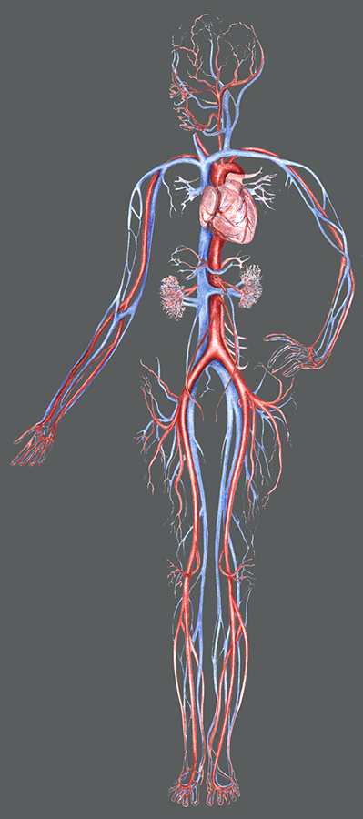
The Cardiovascular System

Slide 2
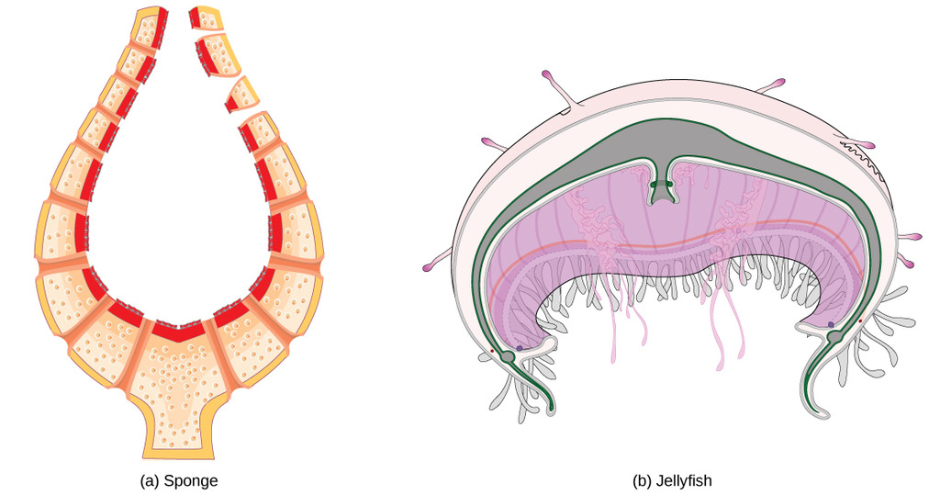
Animals without Circulatory Systems

Slide 7
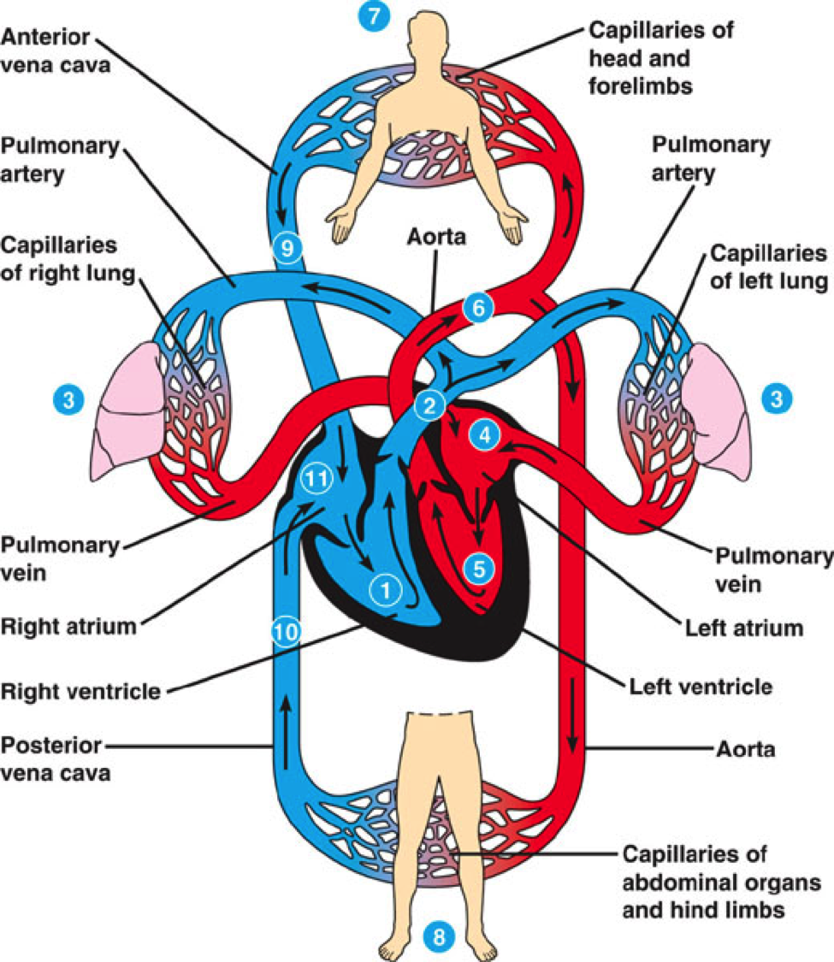
‪www.studyblue.com

Slide 8
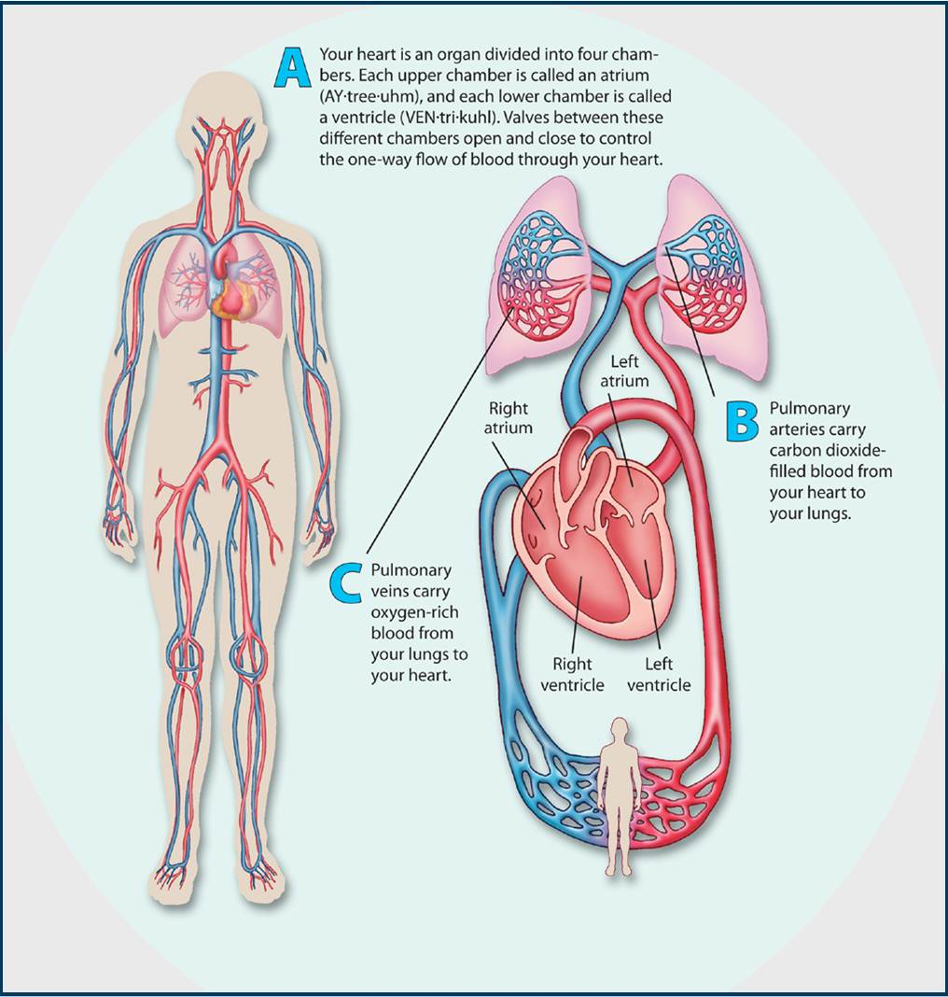

Slide 9
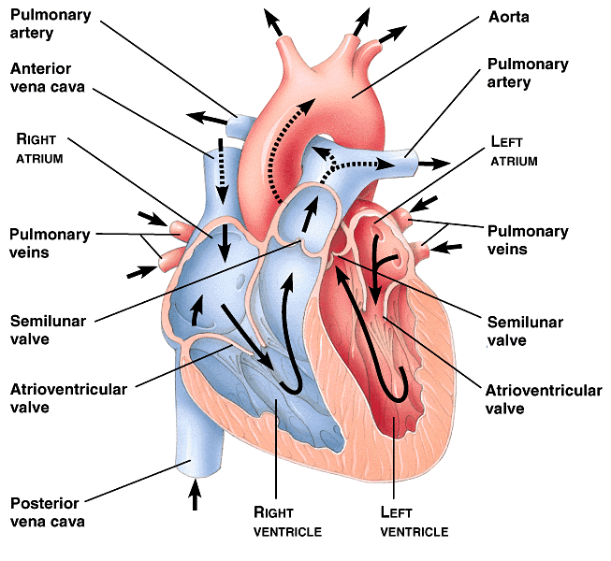
The Mammalian Heart
‪faculty.unlv.edu

Slide 10
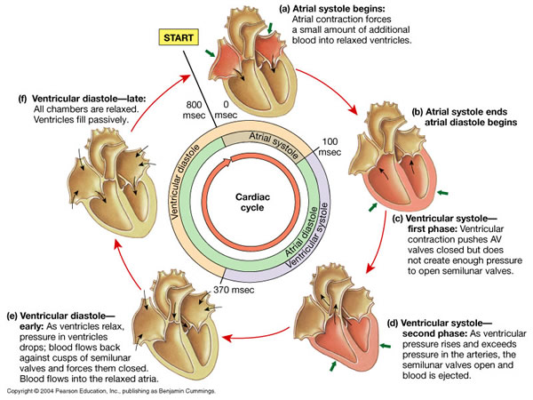
The Cardiac Cycle
‪www.as.miami.edu

Slide 11
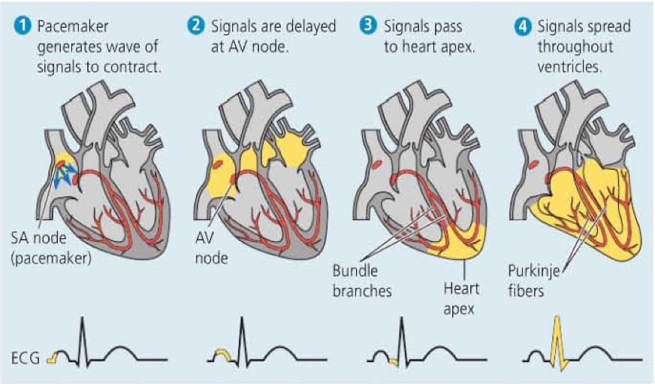
The Control of Heart Rhythm
http://www.youtube.com/watch?v=7N4viIanngg
‪science.kennesaw.edu
Notes:
pər-KIN-jee

