Slide 1
Warm Up
What are the subunits of DNA called?
What are the 3 parts?

Slide 2
What did Griffith discover when he injected a mixture of heat-killed, disease-causing bacteria and live harmless bacteria into mice?

Slide 3
Griffith and Transformation
What did Griffith discover when he injected a mixture of heat-killed, disease-causing bacteria and live harmless bacteria into mice?
The disease-causing bacteria changed into harmless bacteria.
The mice developed pneumonia
The harmless bacteria died
The mice were unaffected

Slide 4
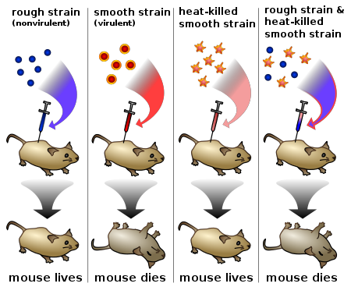

Slide 5
What did Hershey and Chase’s experiments with bacteria and viruses show?

Slide 6
DNA
What did Hershey and Chase’s experiments with bacteria and viruses show?
That the DNA entered the cell of the bacteria
That RNA entered the cell of the bacteria
That the protein entered the cell of the bacteria
That carbohydrates entered the bacteria cell

Slide 7
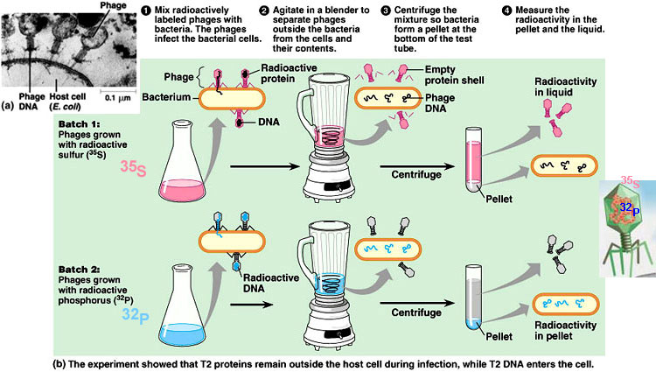

Slide 8
What did Chargaff discover?
What are the implications of his findings?

Slide 9
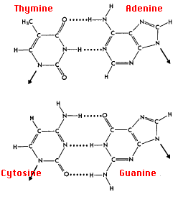

Slide 10
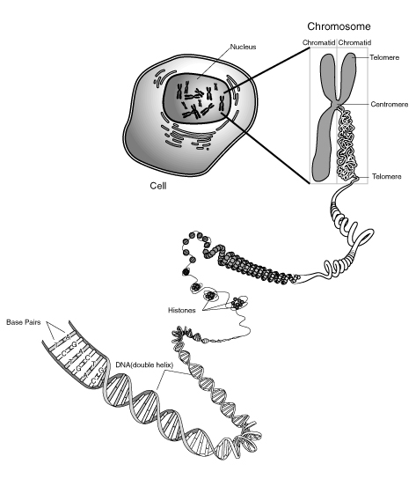
Notes:
The information content of DNA, the genetic material, is in the form of specific sequences of nucleotides along the DNA strands. But how does this information determine an organism’s traits? Put another way, what does a gene actually say? And how is its message translated by cells into a specific trait, such as brown hair or type A blood?

Slide 11
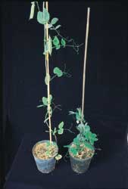
Notes:
Consider again, Mendel’s peas. One of the characteristics Mendel studied was stem length. Mendel did not know the physiological basis for the difference between the tall and dwarf varieties of pea plants, but plant scientists have since worked out this solution: Dwarf peas lack the growth hormones called gibberellins, which stimulate the normal elongation of stems.

Slide 12
Gibberellins = Tall plants
Notes:
A dwarf plant treated with gibberellins from an external source grows to normal height. Why do dwarf peas fail to make their own gibberellins? They are missing a key protein, an enzyme that is required to make gibberellins. And they are missing that protein because they do not have a properly functioning gene for that protein.

Slide 13
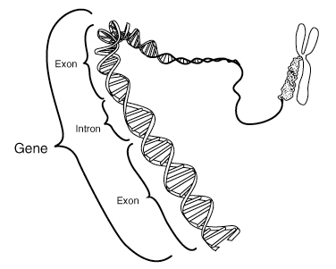
Review: What is a gene?
Notes:
Gene: a discrete unit of hereditary information consisting of a specific nucleotide sequence of DNA.
HS: Gene: sequence of DNA that codes for a protein and thus determines a trait.

Slide 14
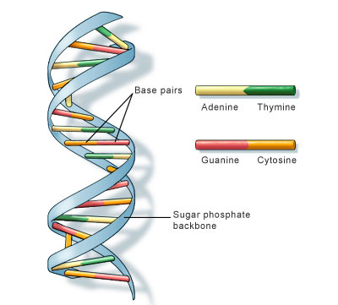
12-1 DNA
Structure
DNA – long molecule made of Nucleotides, each nucleotide has 3 parts.
a. 5-carbon sugar (deoxyribose)
b. Phosphate group
c. Nitrogen base

Slide 15
Base Pairs
Four types of nitrogen bases in DNA.
Adenine (A) and Guanine (G) = larger purines.
- Purines have two rings in their structure.
Thymine (T) and Cytosine (C) = smaller pyrimidines.
- Pyrimidines have one ring in their structure.

Slide 16
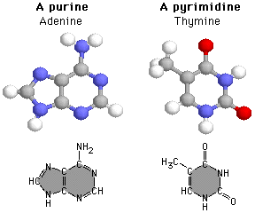

Slide 17
DNA
DNA Structure
The sugar and phosphate form the backbone of the DNA.
The nitrogen bases attach to the backbone, sticking out sideways.
Hydrogen bonds hold the nitrogen bases of the two strands of DNA together.

Slide 18
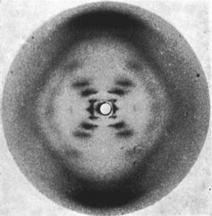
X-Ray Images of DNA

Slide 19
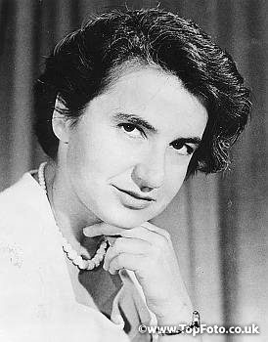
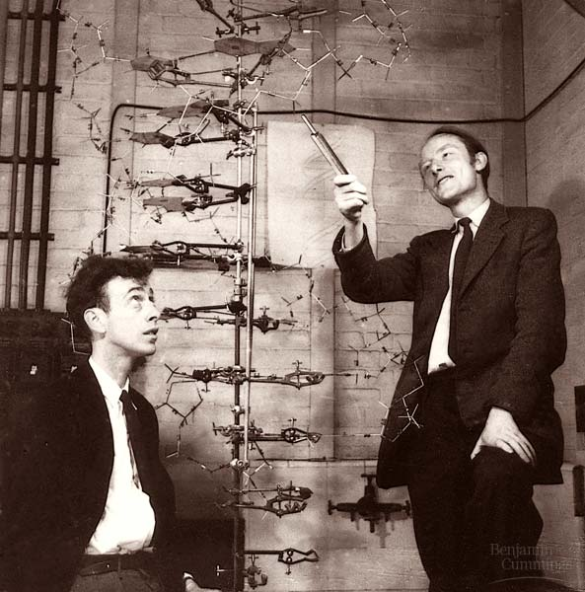
The structure of DNA is discovered
Rosalind Franklin
used X-Ray diffraction to study DNA.
the X-Rays produced an X-Shaped pattern that twists around each other.
Watson and Crick looked at Franklin’s X-Rays & published a paper stating the structure of DNA was a double helix, in which two strands were wound around each other.

Slide 20
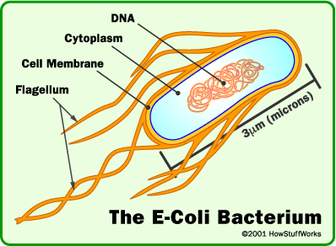
12-2 DNA in Prokaryotes
Prokaryotes do not have a nucleus
They have a single strand of DNA, located in the cytoplasm

Slide 21
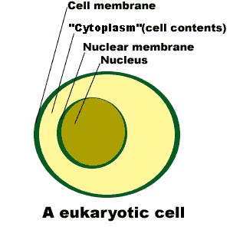
DNA in Eukaryotes
DNA located in the Nucleus.
Very long DNA molecules are folded to fit inside nucleus.

Slide 22
The rule of base-pairing
Adinine (A) always pairs with Thymine (T).
Guanine (G) always pairs with Cytosine (C).
Example:
ACTGACGGGCAAT - Old Strand
TGACTGCCCGTTA – New Strand

Slide 23
DNA Replication
DNA Polymerase
Main enzyme involved in DNA Replication.
b. It adds nucleotides to produce the new strand of DNA
c. It Proofreads the new strand to find and correct mistakes.

Slide 24
DNA Replication
During replication:
* Helicase separates or unzips the original DNA strand
* DNA Polymerase adds nucleotides using rules of base pairing
* 2 new DNA molecules are created, each containing an original strand and a new strand.

Slide 25
Prokaryotes – Replication starts at a single point and goes in 2 directions.
Eukaryotes – Replication can start in hundreds of places and proceed in both directions.

Slide 26
Test Practice Questions
Chromosomes include
DNA Molecules
Histones
Nucleosomes
All of the above

Slide 27
Test Practice Questions
A DNA strand that had the bases ATGCCT would produce a strand with the bases ________ during replication.
TUCTTA
GCAUUA
TACGGA
CGTAAG

Slide 28
Test Practice Questions
The observation of base-pairing in DNA structure indicates that the percentage of
Adenine molecules are equal to cytosine molecules.
Cytosine molecules are equal to Thymine molecules.
Pyrimidines are equal to purines.
Pyrimidines is greater than the percentage of purines.

Slide 29
RNA and Protein Synthesis
Differences Between RNA and DNA:
RNA DNA
Sugar = Ribose Sugar = Deoxyribose
Single Strand Double Stranded
Uracil replaces Thymine

Slide 30
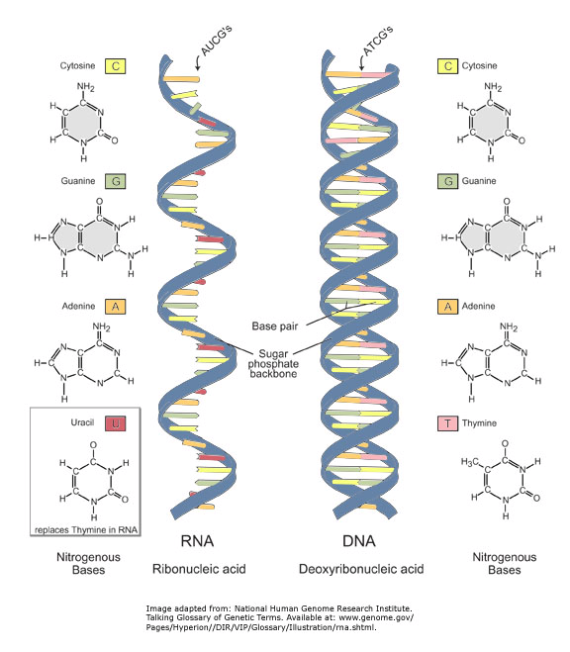

Slide 31
RNA’s job is Protein Synthesis: linking amino acids to make proteins.
3 types of RNA
Messenger RNA (mRNA) – Copied directly from DNA. Carries copies of DNA to rest of cell.
Ribosomal RNA (rRNA) – Assembles proteins on ribosomes.
Transfer RNA (tRNA) – Transfers amino acids to the ribosome to create protein molecules.
* All are copied from DNA

Slide 32
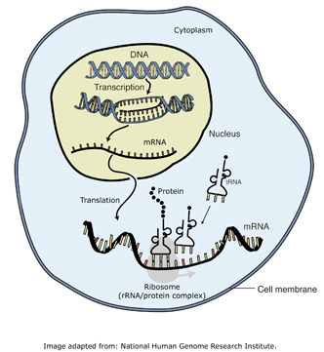

Slide 33
Transcription
C. Transcription (occurs inside nucleus)
1. During Transcription, part of the nucleotide sequence of DNA is copied into a complementary sequence of RNA.
2. __________ is the enzyme used for transcription.
3. __________uses 1 strand of DNA as a template to make mRNA.

Slide 34
Transcription
Promoters are “binding sites” in DNA that tell the enzyme where to start.
A similar region tells the enzyme to stop.
(Play video)

Slide 35
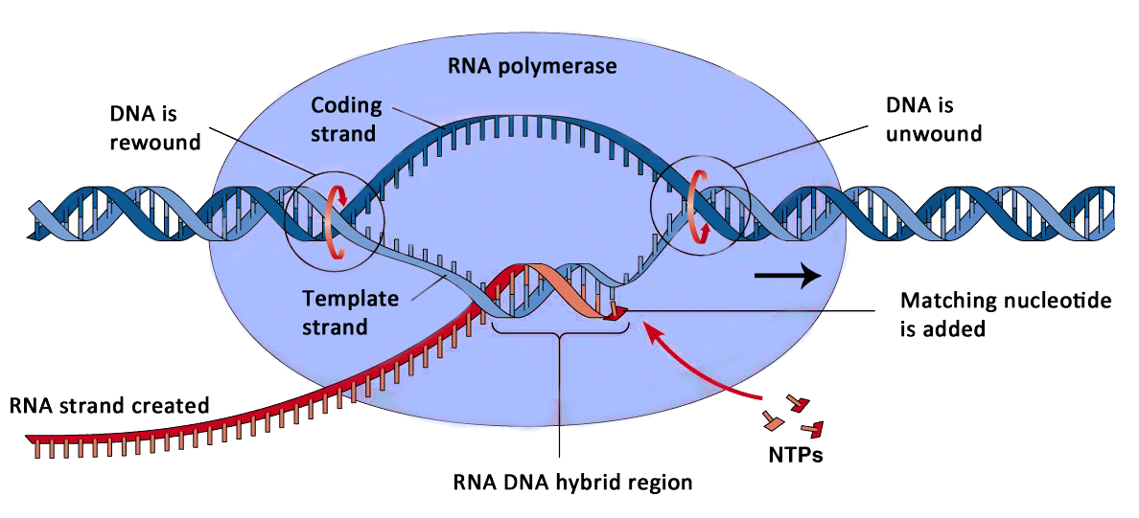

Slide 36
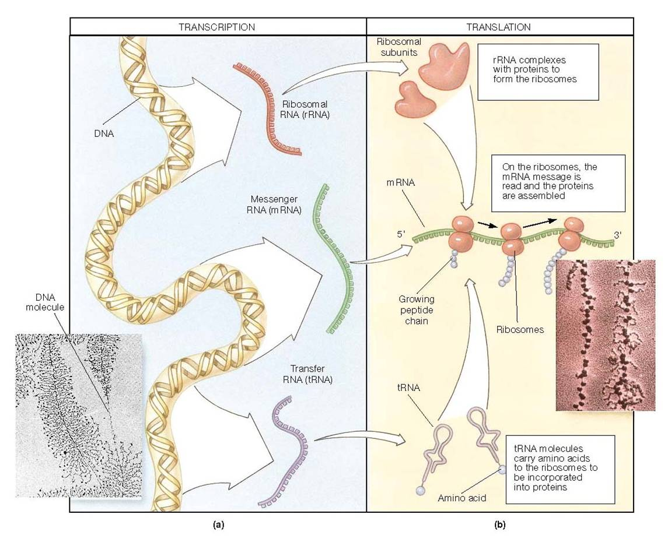

Slide 37
RNA Editing
Many RNA molecules contain more nucleotides than are needed, so they are edited.
Introns – the sequences that are cut out of the RNA.
Exons – The expressed sequences.

Slide 38
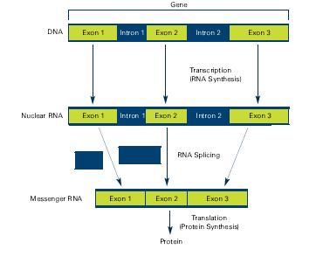

Slide 39
Translation
The Genetic Code
Proteins are made by joining amino acids into a long chain called polypeptides.
Codons specify amino acids.
A Codon is a sequence of 3 nucleotides.
64 possible three-base codons.
Only 20 amino acids

Slide 40
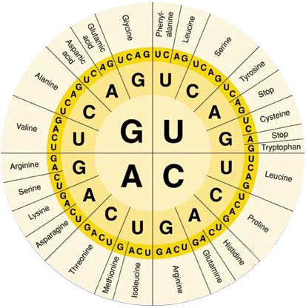
The Genetic Code

Slide 41
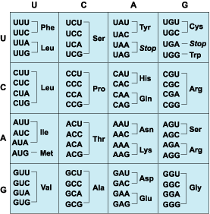
Some amino acids are coded for by
more than one codon!

Slide 42
Chill Point
What are codons?
Where are the codons found?

Slide 43
How many codons are needed to specify 4 amino acids?
4
8
12
16

Slide 44
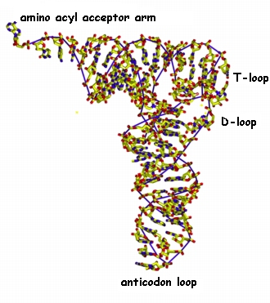
Translation
During Translation information from mRNA is used to make proteins. (Occurs in the cytoplasm)
1. mRNA attaches to a ribosome.
2. tRNA brings amino acids to the ribosome.
3. Anticodons on tRNA match up with the codons on the mRNA.

Slide 45
the amino acids link up to form a polypeptide chain, or protein.
5. Translation ends at the “stop codon.”

Slide 46
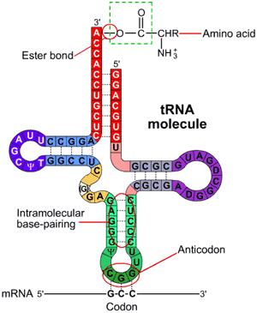

Slide 47
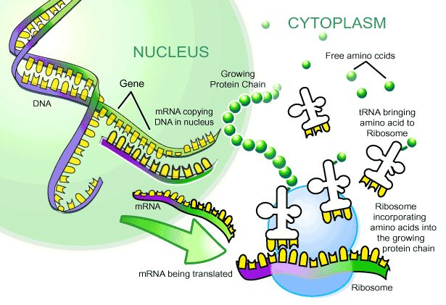

Slide 48
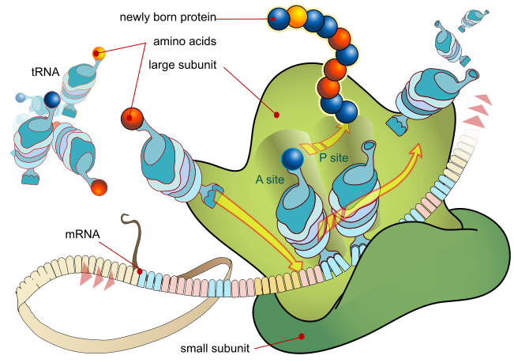
Translation

Slide 49
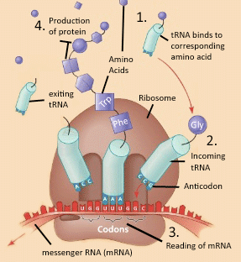

Slide 50
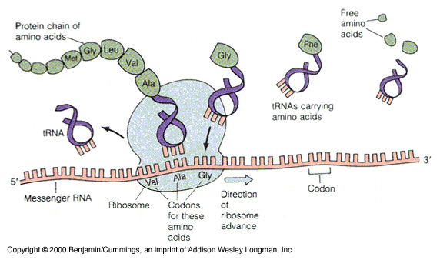

Slide 51
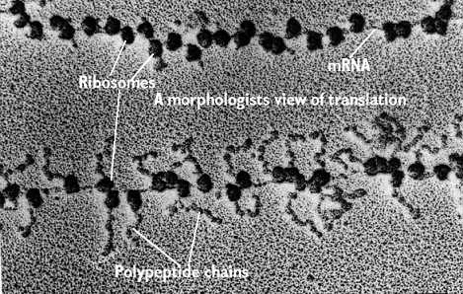

Slide 52
H. Genes and Proteins 1. Genes are instructions for assembling proteins. 2. Inherited traits depend on the proteins coded by genes DNA → RNA → Protein
The role of RNA and DNA
DNA = The master Plan (the original)
RNA = Blueprint (copy that is moved around)

