Slide 1
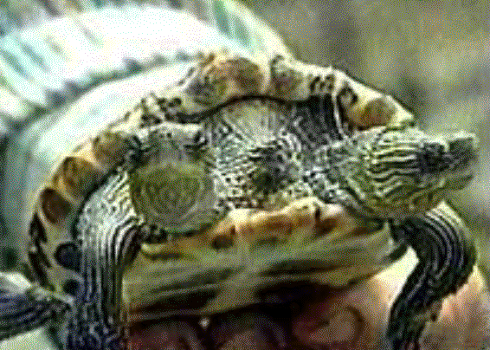
Mutations

Slide 2
Mutations
From the Latin word mutare, meaning “to change”
Changes in the DNA sequence that affect genetic information.

Slide 3
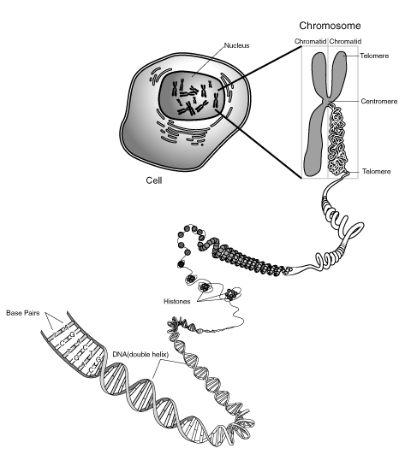
There are two categories of mutations.

Slide 4
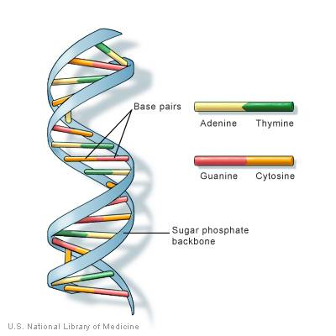
Gene Mutations
Result from changes in a single gene.

Slide 5
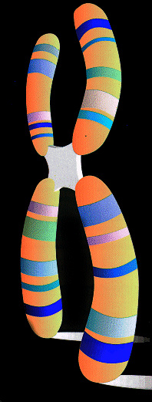
Chromosomal Mutations
Involve changes in whole
chromosomes.

Slide 6
Gene Mutations
Point Mutations
- Occur at a single “point” in DNA
- Affect just one nucleotide
Insertion Deletion Substitution

Slide 7
Deletion
ACT TTC AAA GGC GGA TTT – Original
ACT TTC AAG GCG GAT TT – New

Slide 8
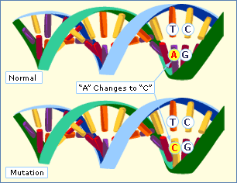
Point Mutations
Substitution

Slide 9
Gene Mutations
Frameshift Mutations
- Insertions and Deletions
- They shift the “reading frame” of Codons

Slide 10
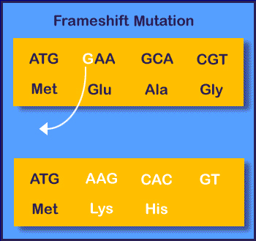

Slide 11
Chromosomal Mutations
- Deletion, Duplication, Inversion, Translocation

Slide 12
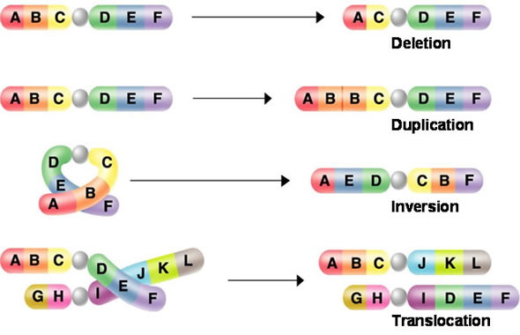
Notes:
A deficiency is the loss of a chromosomal end fragment. Since it occurs normally only in one of two homologous partners, the result is a pairing of a defect and an intact chromosome. Deficiencies can be recognized by this. The intact partner chromosome shows how large the missing fragment of the defect chromosome is. A deletion is the loss of an inner chromosomal fragment. It can be recognized by a loop of the intact partner chromosome at the site where the missing fragment would have been in the defect chromosome. The loop allows conclusions about the size and the site of the deletion. A duplication is the doubling of one or several chromosomal fragments. It shows also as a loop but this time, the loop is in the defect partner chromosome. To find out, whether the loop has been caused by a deletion or a duplication, the band pattern of the chromosome has to be analyzed. The mutation is caused by a duplication, if the band pattern of the loop occurs twice. Usually, the pattern can be found again in a domain neighbouring the loop. The loop is caused by a deletion, if a fragment is missing. An inversion is the change of direction of a chromosomal segment. It results from a segment that has broken out of the chromosome and fused again at the same site but with inverted direction. A pairing of homologous chromosomes is possible, though rather complex loops may be formed. A translocation is the transfer of a chromosomal segment onto a non-homologous chromosome. Translocations were shown in a number of species, like maize Oenothera and others.

