Slide 1
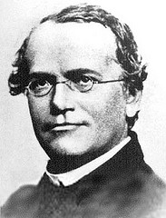
Gregor Mendel

Slide 2
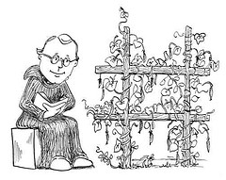

Slide 3
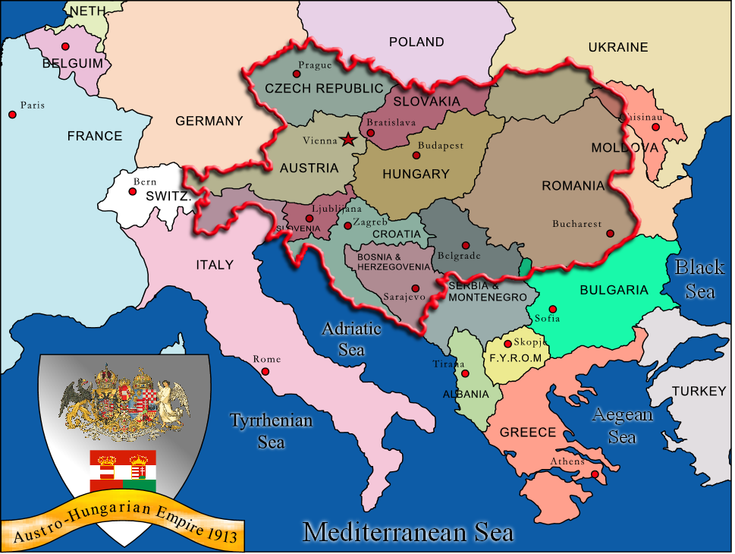

Slide 4
Trait:
A specific characteristic that varies from one individual to another.

Slide 5
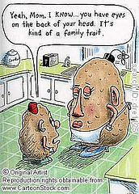
Traits

Slide 6
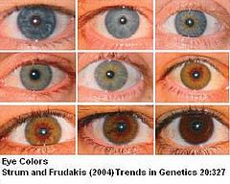
Traits

Slide 7
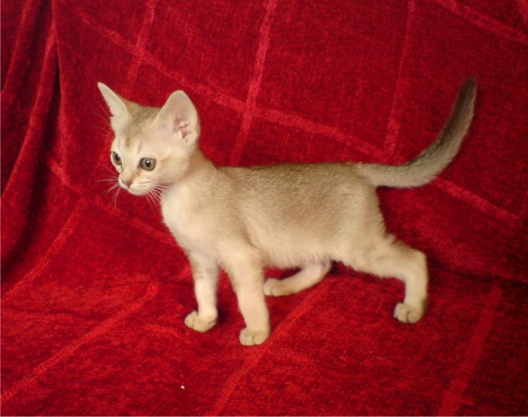

Slide 8
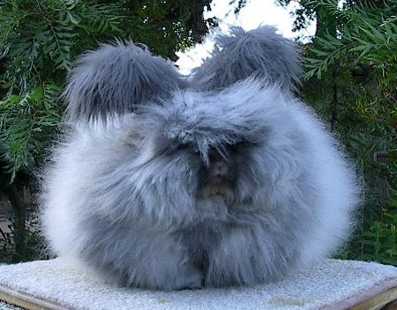

Slide 9
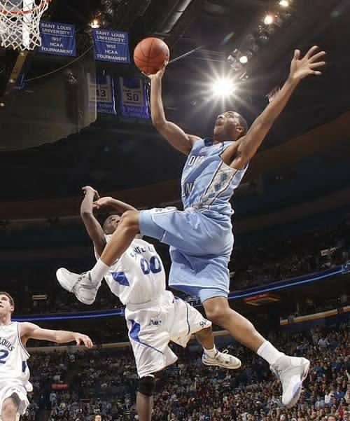

Slide 10
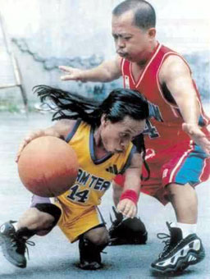

Slide 12
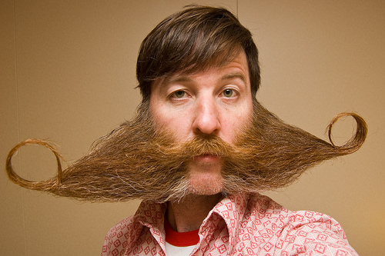

Slide 13
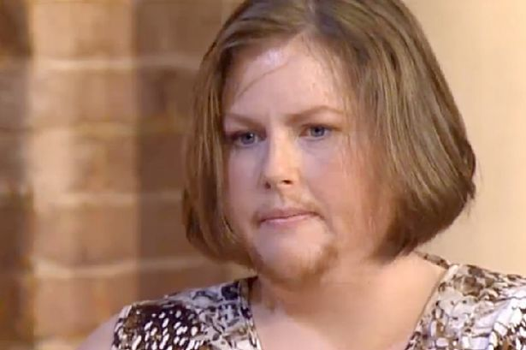

Slide 14
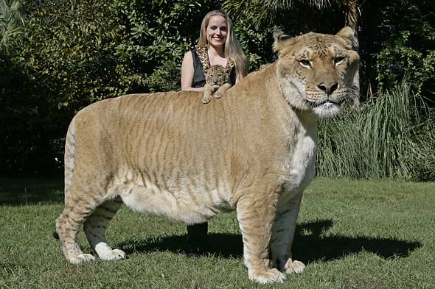

Slide 15
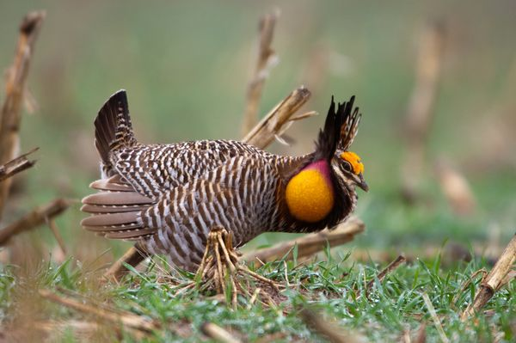

Slide 16
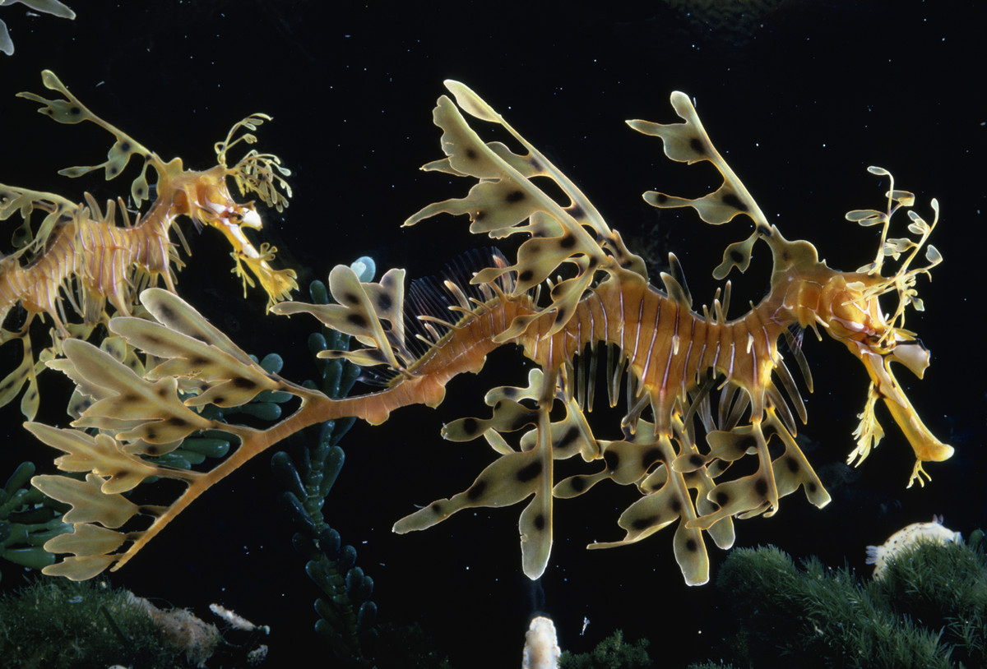

Slide 17
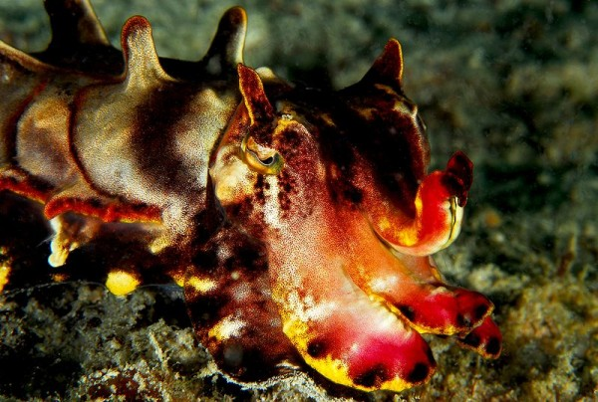

Slide 18
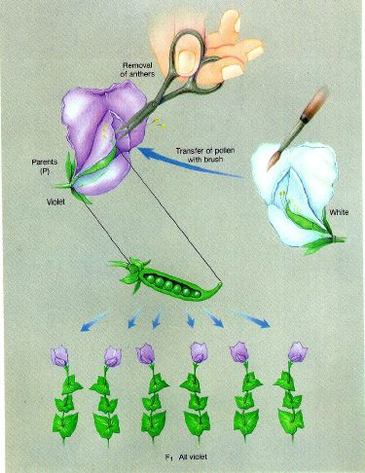

Slide 19
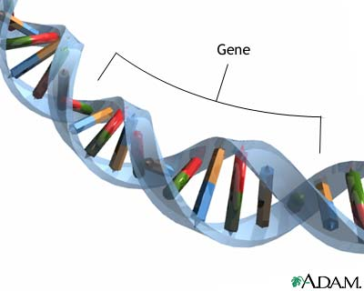
P (parental) generation
F1 (first filial) generation
Hybrid – the offspring of crosses between parents with different traits
Genes – The chemical factors that determine traits; a sequence of DNA
Alleles – The different forms of the same gene

Slide 20
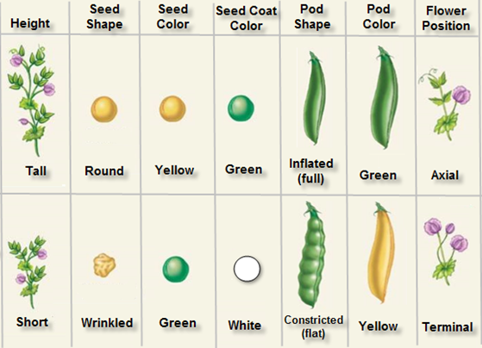
Notes:
improve

Slide 21
Mendel’s Question: “Had the unseen alleles disappeared, or were they still present in the F1 plants?”
He crossed the F1 generation with the F1 generation to produce the F2 generation

Slide 22
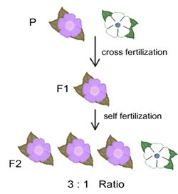

Slide 23
The F1 Cross
The recessive alleles reappeared, ¼ of the offspring contained the recessive traits

Slide 24
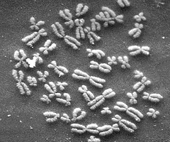
Principle of Dominance
Some Alleles are dominant and
others are recessive

Slide 25
Dominance and recessive
Dominant: need only 1 dominant allele for the trait to be expressed
Recessive: need both recessive alleles for the trait to be expressed

Slide 26
Law of Segregation

Slide 27
Explaining the F1 Cross
When each F1 plant flowers, the two alleles are segregated from each other so that each gamete carries only a single copy of each gene. Therefore, each F1 plant produces two types of gametes – those with the allele for tallness and those with the allele for shortness.

Slide 28
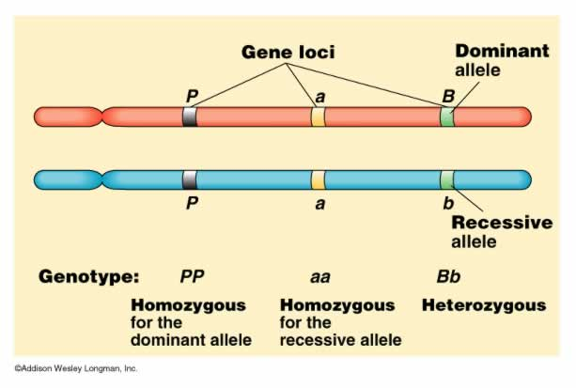

Slide 29
The principles of probability can be used to predict the outcomes of genetic crosses.
Punnett Squares: Handy diagram for predicting the allele composition of offspring from a cross between individuals of known genetic makeup.

Slide 30
Homozygous (purebred or true breeding) – Organisms that have two identical alleles for a particular trait.
Heterozygous (hybrid) – organisms that have two different alleles for the same trait.

Slide 31
Phenotype – Physical traits of an organism (stated in words, e.g. red hair, blue eyes, etc.)
Genotype – Genetic makeup of an individual (stated in letters, e.g. Rr, dd)

Slide 32
II. Probability and Punnett Squares
Mendel realized that the principle of probability could be used to explain the results of genetic crosses. The way in which alleles segregate is completely random, like a coin flip.

Slide 33
A. Genetics and Probability
Probability – the likelihood that a particular event will occur
When flipping a coin P (head) = ½ p (tail) = ½
If you flip a coin three times in a row, what is the probability that it will land heads up each time?
½ X ½ X ½ = 1/8

Slide 34
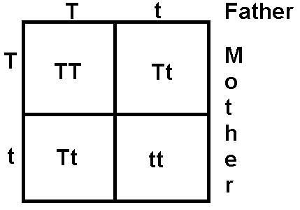

Slide 35
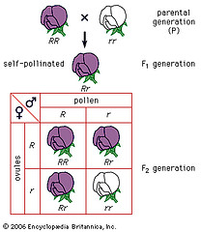
Probability and Punnett Squares

Slide 36
C. Probability and Segregation
Probability proved that Mendel’s assumptions about segregation had been correct.
His predicted ratio of three dominant to one recessive showed up consistently when crossing two hybrid pea plants

Slide 37
D. Probabilities Predict Averages
Probabilities predict average outcomes of a large number of events.
They do not predict the precise outcome of an individual event.
The larger the number of individuals, the closer the resulting offspring numbers will get to expected values.

Slide 38
Exploring Mendelian Genetics
Does the segregation of one pair of alleles affect the segregation of another pair of alleles? Does the gene that determines whether a seed is round or wrinkled in shape have anything to do with the gene for seed color?

Slide 39
Two – Factor Cross
F1 dihybrid cross: - rryy X RRYY
Diagram on board

Slide 40
1st generation’s genotype = 100% hybrid RrYy
1st generation’s phenotype = all show dominant traits

Slide 41
Two Factor Cross
F2 Generation:
Genotypes?
Phenotypes?

Slide 42
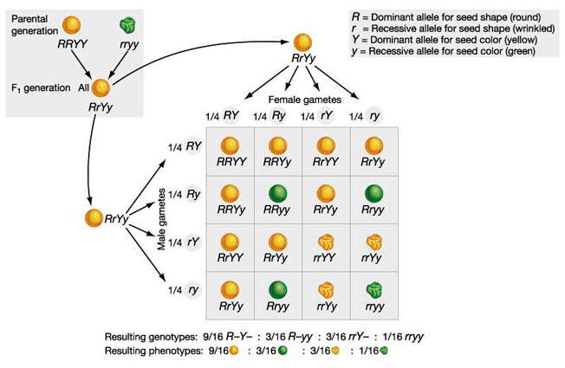

Slide 43
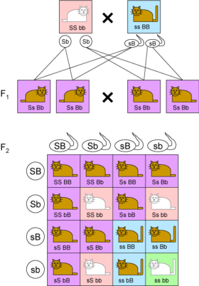

Slide 44
Law of Independent Assortment
Genes for different traits can segregate
independently during the formation of gametes.

Slide 45
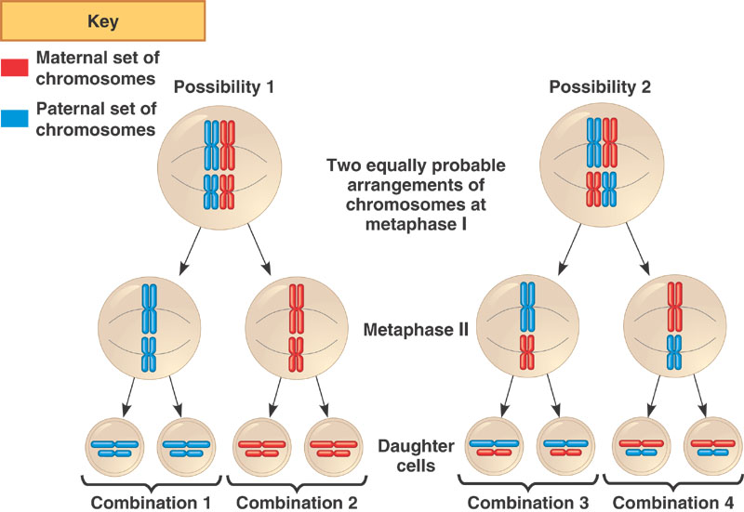

Slide 46
Summary of Mendel’s Principles
1. Inheritance is influenced by genes passed from parents to offspring.
Genes may be dominant or recessive.
Adults have 2 copies of each gene which segregate when gametes are formed.
The alleles for different genes segregate independently of one another.

Slide 47
Beyond Dominant and Recessive Alleles
Some alleles are neither dominant nor recessive, and many traits are controlled by multiple alleles or multiple genes.

Slide 48
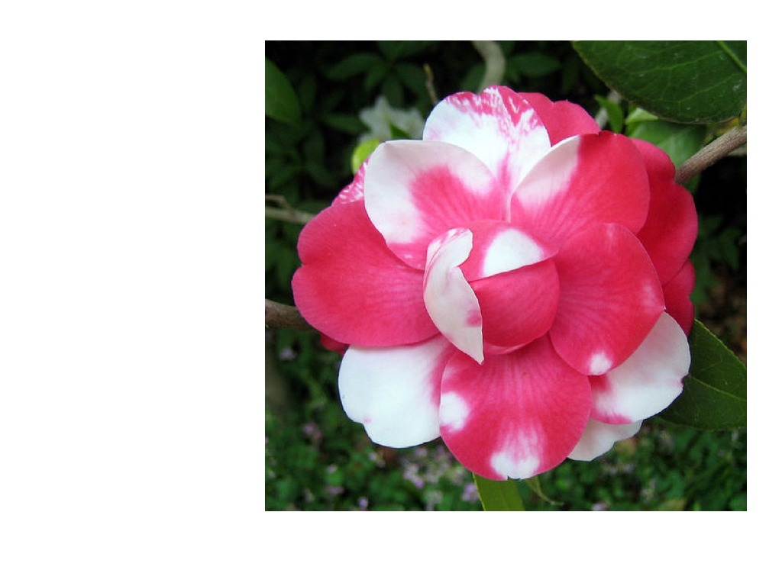
Codominance – Both alleles contribute to the phenotype.
Notes:
In codominance, neither phenotype is recessive. Instead, the heterozygous individual expresses both phenotypes. A common example is the ABO blood group system. The gene for blood types has three alleles: A, B, and i. i causes O type and is recessive to both A and B. The A and B alleles are codominant with each other. When a person has both an A and a B allele, the person has type AB blood.

Slide 49
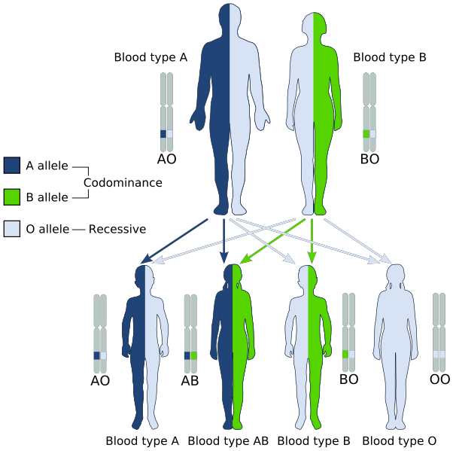

Slide 50
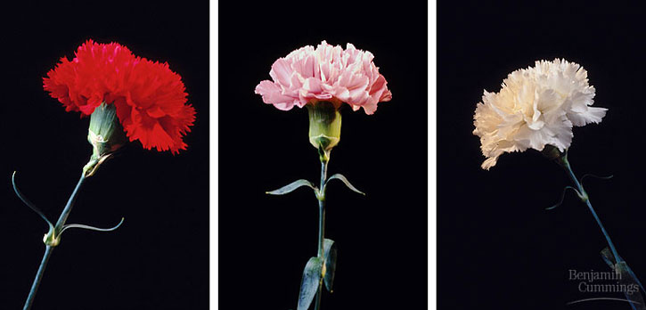
Incomplete dominance – Only one allele (usually the wild type) at the single locus is expressed in a doseage dependent manner, which results in an intermediate phenotype
Notes:
Incomplete dominance (sometimes called partial dominance) is a heterozygous genotype that creates an intermediate phenotype. In this case, only one allele (usually the wild type) at the single locus is expressed in a doseage dependent manner, which results in an intermediate phenotype. A cross of two intermediate phenotypes (= monohybrid heterozygotes) will result in the reappearance of both parent phenotypes and the intermediate phenotype. The classic example of this is the color of flowers.
In codominance, neither phenotype is recessive. Instead, the heterozygous individual expresses both phenotypes. A common example is the ABO blood group system. The gene for blood types has three alleles: A, B, and i. i causes O type and is recessive to both A and B. The A and B alleles are codominant with each other. When a person has both an A and a B allele, the person has type AB blood.

Slide 51
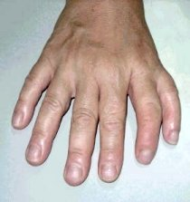
Polydactyly

Slide 52
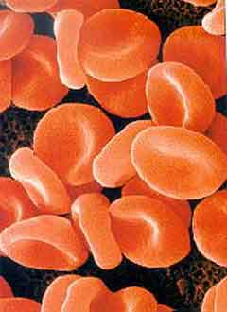

Slide 53
C. Multiple Alleles – Many genes have multiple alleles, like blood type (ABO).

Slide 54
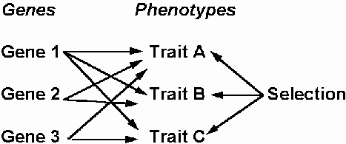
Pleiotropy

Slide 55
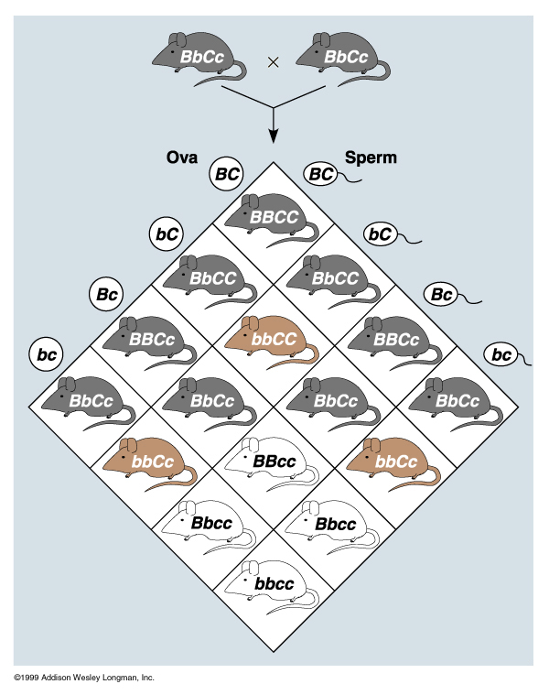
Epistasis

Slide 56
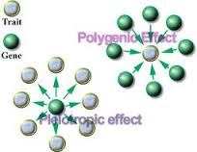
Polygenic Inheritance

Slide 57
D. Polygenic Traits – Traits that are controlled by two or more genes (eye & skin color).
Example: The eyes of Fruit Flies, human skin color, eye color
Thomas Hunt Morgan found that at least three genes are responsible for making the reddish-brown pigment in the eyes of fruit flies.

Slide 58
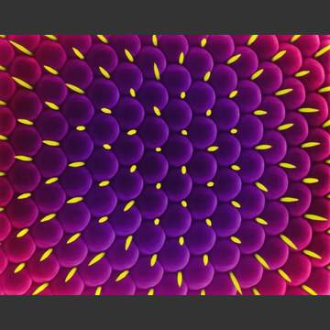

Slide 59
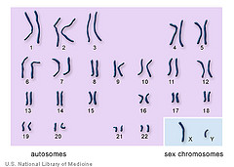
Chromosomes

Slide 60
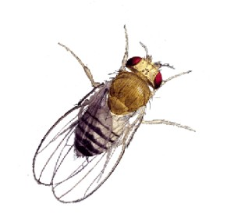
Applying Mendel’s Principles
Thomas Hunt Morgan experimented with fruit flies (drosophila melanogaster) to prove Mendel’s principles.

Slide 62
Gene Linkage
Thomas Hunt Morgan
- Worked with fruit flies because they produce many offspring over a short time.
- His research led him to the principle of linkage.
Notes:
After identifying more than 50 Drosophila genes, Morgan discovered that many of them appeared to be “linked” together in ways that, at first glance, seemed to violate the principle of independent assortment. For example, a fly with reddish-orange eyes and miniature wings, like the one shown in figure 11-18, was used in a series of crosses. The results showed that the genes for those traits were almost always inherited together and only rarely became separated from each other.

Slide 63
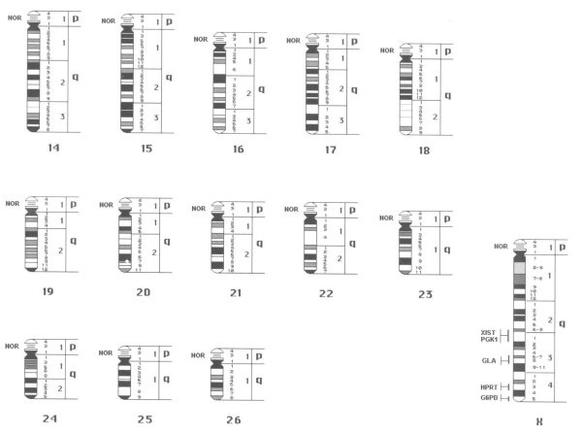
Each chromosome is a group of linked genes.

Slide 64
Gene Maps
Gene Maps show the relative locations of known genes on chromosomes.
Genes that are closer together on the chromosome are more likely to be inherited together, or “linked.”
Genes further apart are less likely to be inherited together.

Slide 65
Gene maps are based on:
- The frequencies of of crossing-over between genes.

