Slide 1
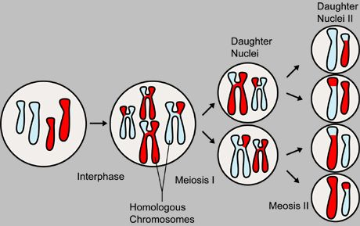
Meiosis
Notes:
Unlike the single-cell division of mitosis, meiosis involves two cellular divisions: meiosis I and meiosis II. Each stage of meiosis runs through the same five stages as discussed in mitosis. During the first round of division, two intermediate daughter cells are produced. By the end of the second round of meiotic division (meiosis II), the original diploid (2n) cell has become four haploid (n) daughter cells.

Slide 2
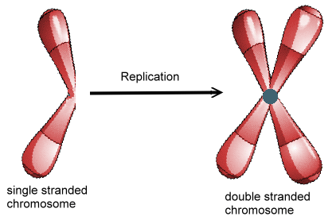

Slide 3
Interphase 1
Cells undergo a round of DNA replication, forming duplicate chromosomes.
Notes:
Just as in mitosis, the cell undergoes DNA replication during this intermediate phase. After replication, the cell has a total of 46 chromosomes, each made up of two sister chromatids joined by a centromere.

Slide 4
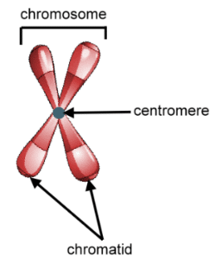
Review

Slide 5
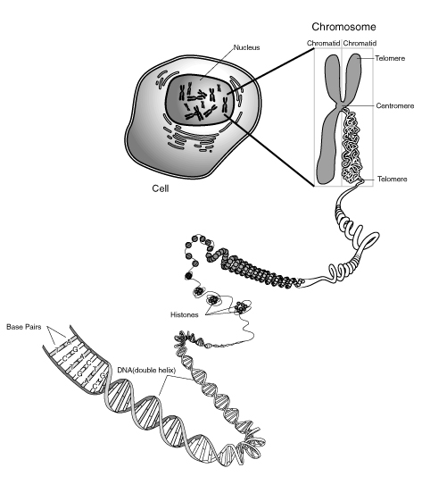
V
Supercoiling
DNA Wrapping
Notes:
https://www.youtube.com/watch?v=N5zFOScowqo
http://www.dnalc.org/resources/3d/DNAWrapBasic_withFX01.html

Slide 6
Meiosis is a process of cell division in which the number of chromosomes per cell is cut in half.

Slide 7
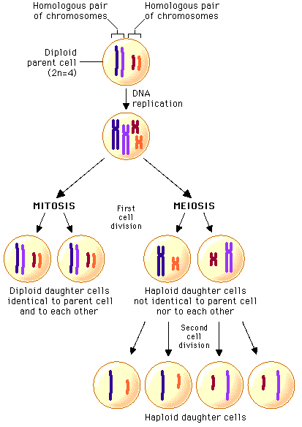

Slide 8
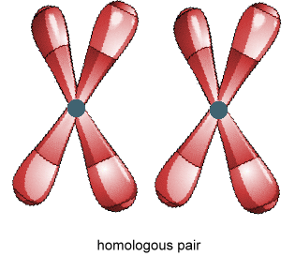
Meiosis 1
Prophase 1
Each chromosome pairs with its corresponding homologous chromosome to form a tetrad.
Notes:
The major distinction between mitosis and meiosis occurs during this phase. In mitotic prophase, the double-stranded chromosomes line up individually along the spindle. But in meiotic prophase I, chromosomes line up along the spindle in homologous pairs. Then, in a process called synapsis, the homologous pairs actually join together and intertwine, forming a tetrad (two chromosomes of two chromatids each, or four total chromatids). Often this intertwining leads the chromatids of homologous chromosomes to actually exchange corresponding pieces of DNA, a process called crossing-over or genetic reassortment. Throughout prophase I, sister chromatids behave as a unit and are identical except for the region where crossover occurred.

Slide 9
Homologous pair – each of the chromosomes that came from the female parent pairs with chromosomes that came from the male parent.
Called a tetrad

Slide 10
A cell that has both sets of homologous chromosomes is diploid, which means “two sets.”
2N
The gametes, reproductive cells, only have a single set of chromosomes, called haploid. Means “one set.”
N (humans, N=23)
(Fruit Flies, N=4)
Notes:
In order for sexual reproduction to take place, however, the parents first need to have haploid sperm or ova, also called sex cells, germ cells, or gametes

Slide 11
Back to Meiosis…
Prophase 1
Each chromosome pairs with its corresponding homologous chromosome to form a tetrad
This is where crossing - over occurs.
Notes:
The major distinction between mitosis and meiosis occurs during this phase. In mitotic prophase, the double-stranded chromosomes line up individually along the spindle. But in meiotic prophase I, chromosomes line up along the spindle in homologous pairs. Then, in a process called synapsis, the homologous pairs actually join together and intertwine, forming a tetrad (two chromosomes of two chromatids each, or four total chromatids). Often this intertwining leads the chromatids of homologous chromosomes to actually exchange corresponding pieces of DNA, a process called crossing-over or genetic reassortment. Throughout prophase I, sister chromatids behave as a unit and are identical except for the region where crossover occurred.

Slide 12
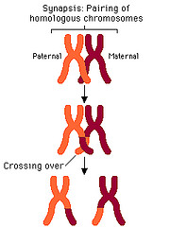

Slide 13
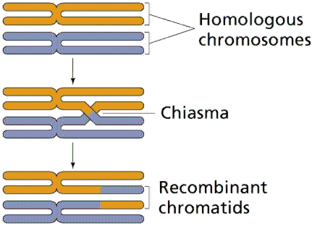
When homologous chromosomes pair up, they sometimes exchange portions of their chromatids in a process called Crossing-over,
* This produces new combinations of alleles in the gametes.

Slide 14
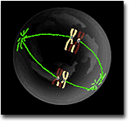
Metaphase 1
Spindle Fibers attach to the chromosomes.
Notes:
After prophase I, the meiotic cell enters metaphase I. During this phase, the nuclear membrane breaks down, allowing microtubules access to the chromosomes. Still joined at their crossover regions in tetrads, the homologous pairs of chromosomes, with one maternal and one paternal chromosome in each pair, align at the center of the cell via microtubules, as in mitotic metaphase. The pairs align in random order.

Slide 15
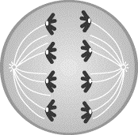
Anaphase 1
The fibers pull the homologous chromosomes toward opposite ends of the cell.
Notes:
Anaphase I differs slightly from its mitotic counterpart. In mitotic anaphase, sister chromatids split at their centromeres and are pulled apart toward opposite poles. In contrast, during anaphase I, the centromeres do not split: the entire maternal chromosome of a homologous pair is pulled to one end, and the paternal chromosome is pulled to the other end.

Slide 16
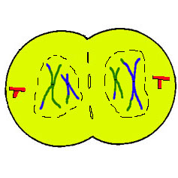
Telophase 1 and cytokinesis
Nuclear membranes form and the cell separates into two cells.
Notes:
During telophase I, the chromosomes arrive at separate poles and decondense. Nuclear membranes re-form around them. The cell physically divides, as in mitotic cytokinesis.

Slide 17
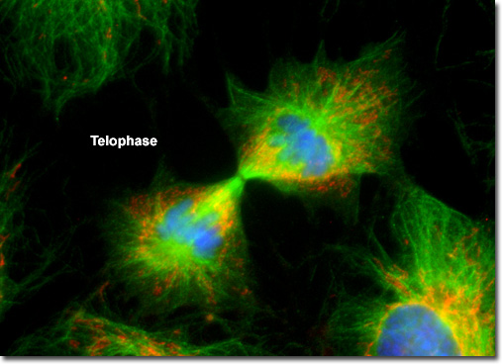
Notes:
Meiosis I results in two independent cells. One cell contains the maternal homologous pair, with a small segment of the paternal chromosome from crossover. The other cell contains the paternal homologous pair, likewise with a small segment of the maternal chromosome. Despite the small region of crossover in the chromosomes of each cell, the maternal sister chromatids are still quite similar, as are the paternal sister chromatids. Both cells formed by meiosis I contain a haploid amount of DNA.

Slide 18
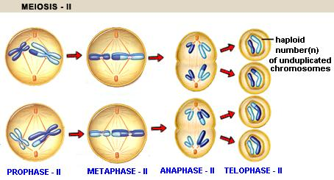
Meiosis 2
Notes:
The cells produced by meiosis I quickly enter meiosis II. These cells do not undergo DNA replication before entering meiosis II. The two cells that move from meiosis I into meiosis II are haploid—each have 23 replicated chromosomes, rather than the 46 that exist in cells entering both mitosis and meiosis I.
Meiotic division II occurs through the familiar phases from meiosis I and mitosis. To distinguish the phases, they are called prophase II, metaphase II, anaphase II, and telophase II. One important difference between the events of meiosis I and II is that no further genetic reassortment takes place during prophase II. As a result, prophase II is much shorter than prophase I. In fact, all of the phases of meiosis II proceed rapidly.
During meiosis II, chromosomes align at the center of the cell in metaphase II exactly the way they do in mitotic metaphase. In anaphase II, the sister chromatids separate, once again in the same fashion as occurs in mitotic anaphase. The only difference is that since there was no second round of DNA replication; only one set of chromosomes exists. When the two cells split at the end of meioisis II, the result is four haploid cells.

Slide 19
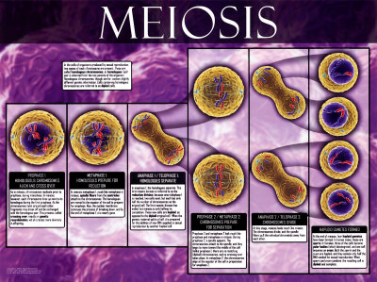
Notes:
Meiotic division II occurs through the familiar phases from meiosis I and mitosis. To distinguish the phases, they are called prophase II, metaphase II, anaphase II, and telophase II. One important difference between the events of meiosis I and II is that no further genetic reassortment takes place during prophase II. As a result, prophase II is much shorter than prophase I. In fact, all of the phases of meiosis II proceed rapidly.

Slide 20
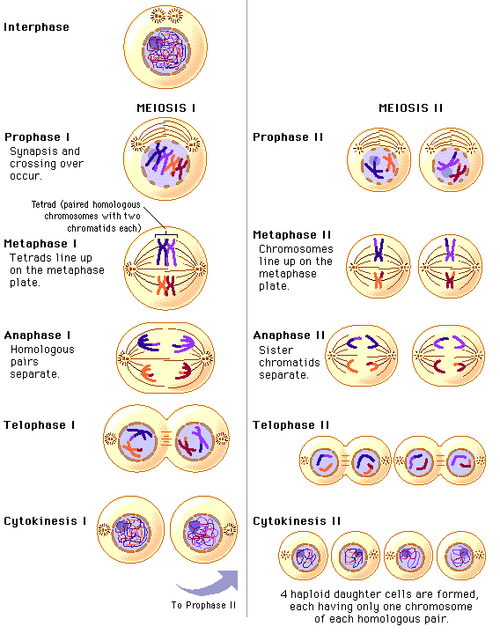
Notes:
Unlike the single-cell division of mitosis, meiosis involves two cellular divisions: meiosis I and meiosis II. Each stage of meiosis runs through the same five stages as discussed in mitosis. During the first round of division, two intermediate daughter cells are produced. By the end of the second round of meiotic division (meiosis II), the original diploid (2n) cell has become four haploid (n) daughter cells.
During meiosis II, chromosomes align at the center of the cell in metaphase II exactly the way they do in mitotic metaphase. In anaphase II, the sister chromatids separate, once again in the same fashion as occurs in mitotic anaphase. The only difference is that since there was no second round of DNA replication; only one set of chromosomes exists. When the two cells split at the end of meioisis II, the result is four haploid cells.

Slide 21
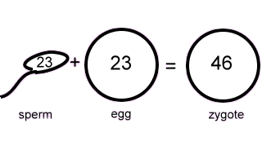
Gametes
Notes:
During sexual reproduction the father’s haploid sperm cell and the mother’s haploid ovum (egg) cell fuse to form a single-celled diploid zygote that then divides billions of times to form a whole individual.

Slide 22
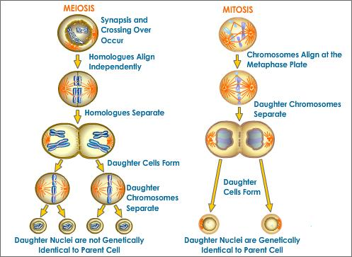

Slide 23
The number of chromosomes is reduced to half between meiosis 1 and 2 because replication does not re-occur at meiosis 2.
Meiosis results in 4 haploid (N) daughter cells.
Compared to mitosis which results in: 2 diploid cells.
Notes:
Of the four haploid cells, one cell is composed completely of a maternal homologue, another of a maternal homologue with a small segment of paternal DNA from crossover in meiosis I, another complete paternal homologue, and a final paternal homologue with a small segment of maternal DNA from crossover in meiosis I. These four haploid cells are the gametes, the sperm or egg cells, that fuse together in sexual reproduction to create new individuals.

