Slide 1
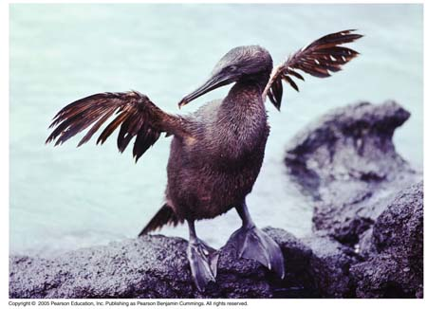
Evolution of Populations

Slide 2
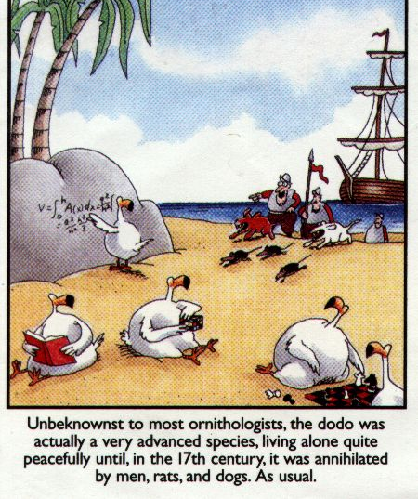

Slide 3
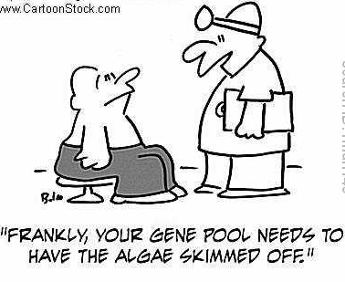
Gene Pools
All of the genes in a population
- Contains 2 or more alleles (forms of a gene) for each trait
2. Relative frequencies - # of times an allele occurs in a gene pool compared to other alleles

Slide 4
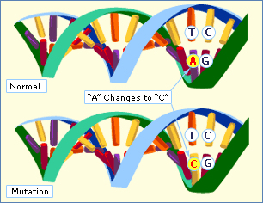
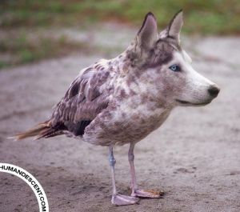
Sources of Genetic Variation
Mutations
- Causes = mistakes in replication, radiation or chemicals
- May or may not effect phenotype

Slide 5
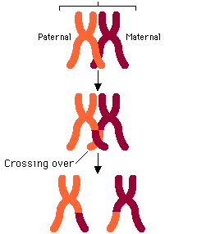
Gene Shuffling – Occurs during production of gametes
- 8.4 million (2^23)different combinations of genes
- Crossing over also increases genotypes

Slide 6
Single Gene and Polygenic Traits
# of phenotypes produced for a given trait depends on the number of genes that control the trait
Single-gene trait – controlled by a single gene that has 2 alleles
Has fewer phenotypes than a polygenic trait
Show’s simple dominant-recessive pattern – Widow’s Peak

Slide 7
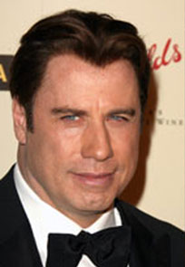

Slide 8
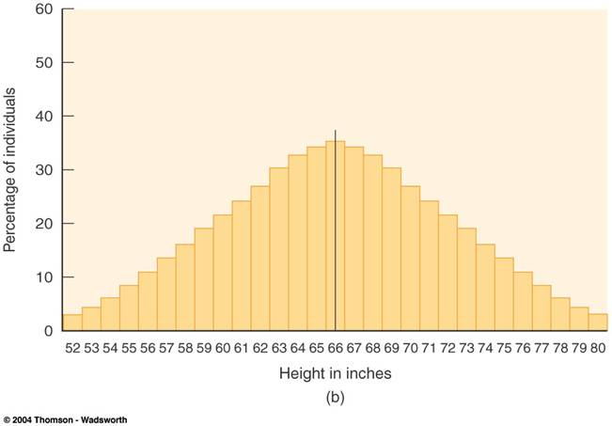
Polygenic Traits – Controlled by 2 or more genes [height]
- Show a wide range of phenotypes

Slide 9
16-2 Evolution as Genetic Change
Natural Selection on Single-gene traits
Can lead to changes in allele frequencies & thus to evolution
White moth vrs. Dark moth
- Frequency of new allele will increase if this mutation makes some individuals more fit for their environment

Slide 10
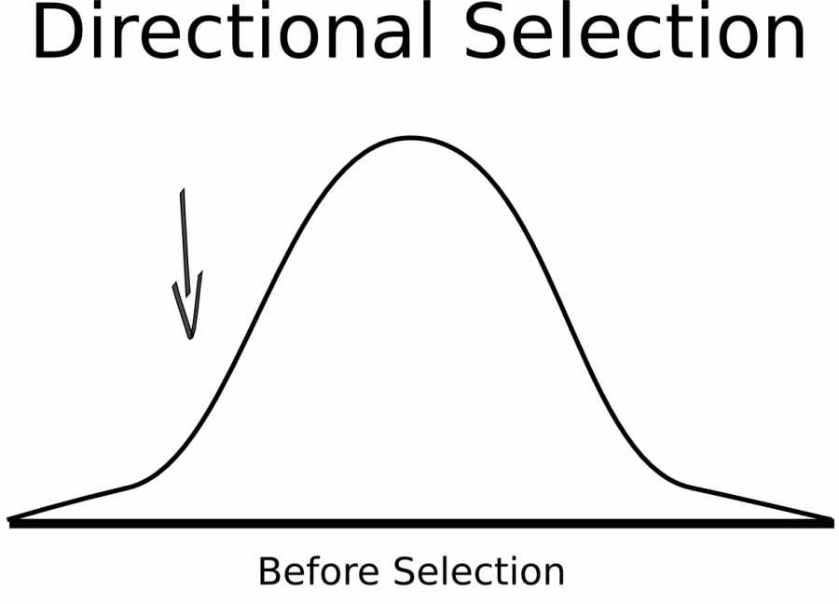
Natural Selection on Polygenic Traits
1. Directional Selection – When individuals at only one end of a bell curve of phenotype frequencies have higher fitness than individuals in the middle or at the other end.

Slide 12
Directional Selection Graphs
Evolution causes an increase in the # of individuals with the trait at one end of the curve
Example: Increase of beak size of finches on the Galapagos

Slide 13
Stabilizing Selection – Individuals with an average form of a trait (near center of curve) have highest fitness
Keeps curve at its current position
Example: birth weight

Slide 15
Disruptive Selection – individuals at both ends of the curve have higher fitness than individuals near the center
Selection acts against intermediate type
Can cause 2 distinct phenotypes
Finches with large or small beaks

Slide 18
Test Prep Questions
Natural Selection acts directly on
Genes
Mutations
Alleles
genotypes

Slide 19
Test Prep Questions
According to the Hardy-Weinberg principle, genetic equilibrium would be more likely in a population if
The population size rapidly decreases
Mutation rates are high
No natural selection takes place
There is frequent movement out of the population

Slide 20
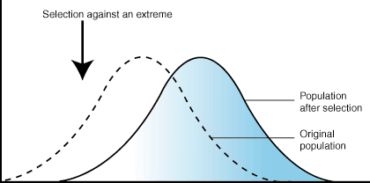
The graph below is an example of
Disruptive selection
Genetic drift
Stabilizing Selection
Directional Selection

Slide 21
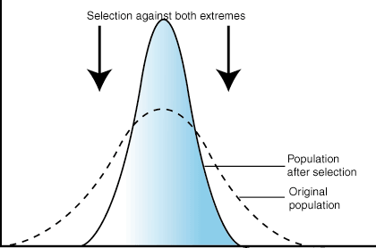
The graph below is an example of
Directional Selection
Stabilizing Selection
Genetic Drift
Gene Pool

Slide 22
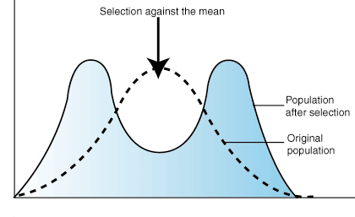
What’s This?

Slide 23
Evolution Versus Genetic Equilibrium
Hardy-Weinberg Principle: Allele frequencies in a population will remain constant unless one or more factors cause them to change.
Genetic Equilibrium: Situation in which allele freq. of a pop. do not change over time.

Slide 24
Process of Speciation
Isolating Mechanisms – As new species evolve, populations become reproductively isolated from each other
Reproductive Isolation – Members of two populations cannot interbreed & produce fertile offspring

Slide 25
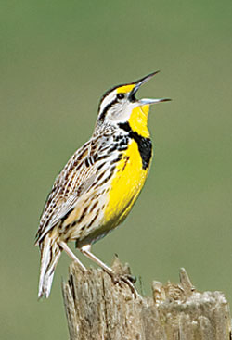
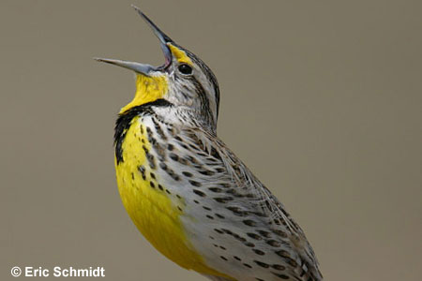
a. Behavioral Isolation: Differences in behavior prevent breeding.
Example: Eastern and western meadowlarks (pg. 404)
Notes:
Wood and leopard frogs exhibit behavioral isolation because the males of each species have vocalizations that only attract females of their species.

Slide 26
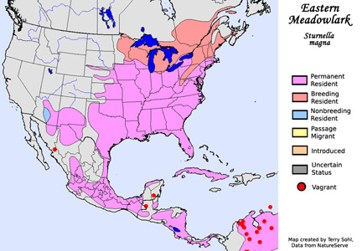

Slide 27
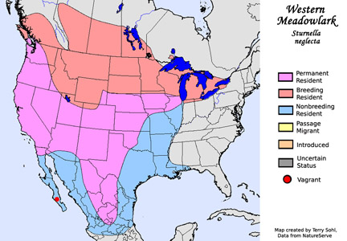

Slide 28
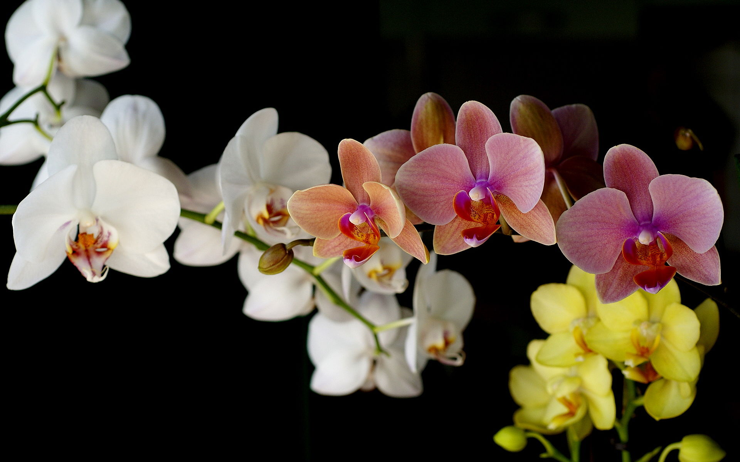
Geographic Isolation: Separation of populations by barriers such as rivers, mountains, canyons, etc.
Temporal Isolation: 2 or more species reproduce at different times.

Slide 29
Testing Natural Selection in Nature (Peter & Rosemary Grant, Darwin’s Finches)
Variation – recorded lots of variation on traits of finches
Natural Selection – big-beaked birds survived during times of food scarcity

Slide 30
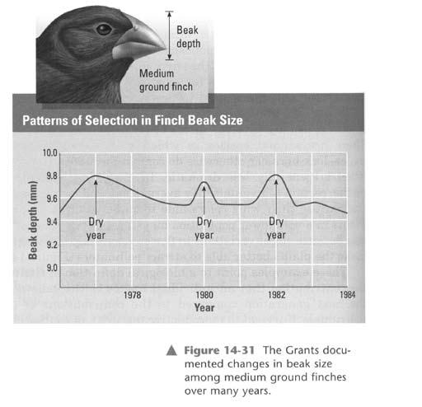

Slide 31
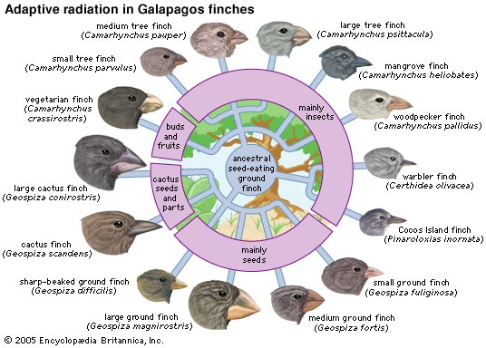
Rapid Evolution – Change in the phenotypes of the finches changed quickly over time, depending on the food supply.

Slide 32
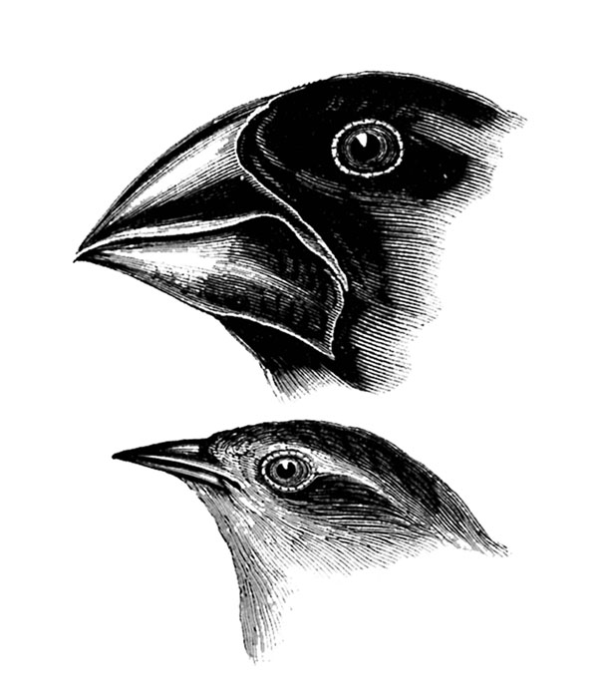
Speciation of Darwin’s Finches
Arrival of the founding population from South America
Separation of populations – island to island
Changes in the Gene Pool – by natural selection

Slide 33
Reproductive Isolation – Birds picked mates with similar sized beaks
Ecological competition – for food during different seasons

Slide 34
Continued Evolution – 13 species of finches exist today
- Example of: adaptive Radiation, the process by which one species evolves into several different forms that live in different ways.

Slide 35
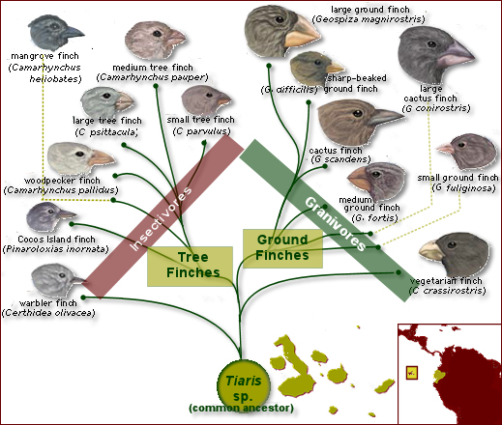

Slide 36
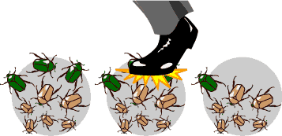
Genetic Drift: Allele frequencies change because of chance.

Slide 37
The combined genetic information of all members of a population forms a
Niche
Phenotype
Gene pool
species

Slide 38
A single species that has evolved into many different forms (i.e. Darwin’s Finches) has undergone
Punctuated Equilibrium
Mass Extinction
Adaptive Radiation
Directional Selection

Slide 39
One factor which is necessary for the formation of a new species is
Geographic barriers
Reproductive isolation
Different mating behaviors
Temporal isolation

Slide 40
Similar organisms that can breed with each other and produce fertile offspring make up a
Species
Gene pool
Population
Clone

Slide 41
The separation of populations that occurs due to timing of reproductive activity is called
Geographic isolation
Behavioral isolation
Temporal isolation
Genetic drift

Slide 42
Genetic drift involves changes in a population due to
Natural selection
Genetic equilibrium
Chance
mutations

Slide 43
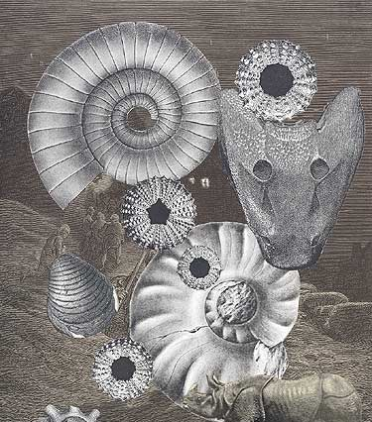
Chapter 17 The History of Life
17-1 The Fossil Record
The Fossil Record provides evidence of the history of life on earth and shows how organisms have changed over time
More than 99% of all
species on earth have
become extinct.

Slide 44
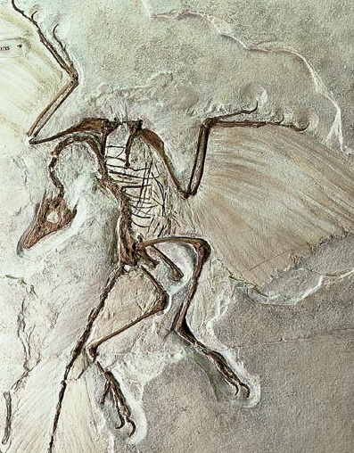
Most fossils form in sedimentary rock (pg.418)
Sedimentary rock forms from particles of sand, silt, and clay.
This process preserves the remains of organisms, forming fossils

Slide 45
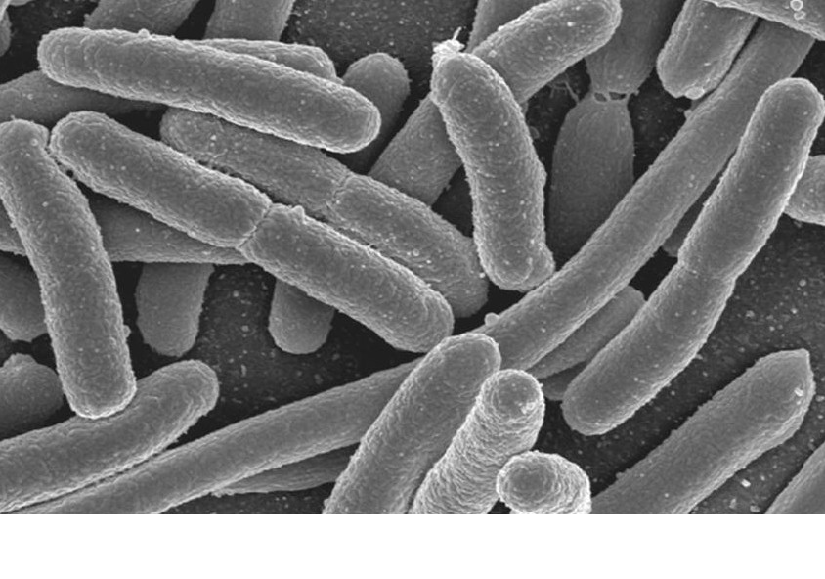
The first organisms on earth were most likely today’s bacteria.

Slide 46
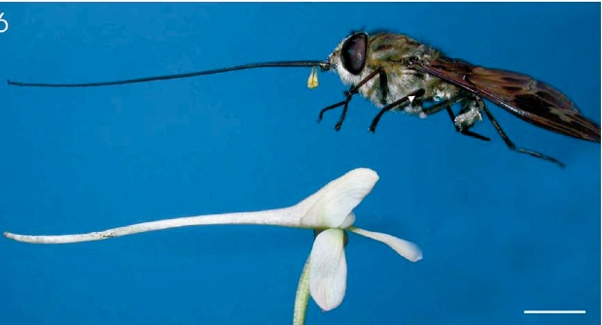
Coevolution: the process by which 2 species evolve in response to each other
- Example: a flower and a pollinating insect

Slide 47
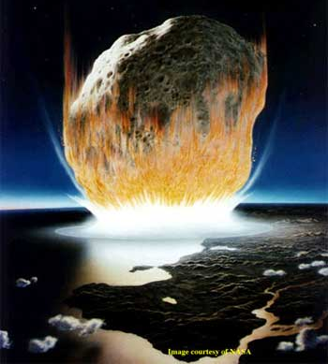
Mass extinction has encouraged the rapid evolution of surviving species by making new habitats available to them.

Slide 48
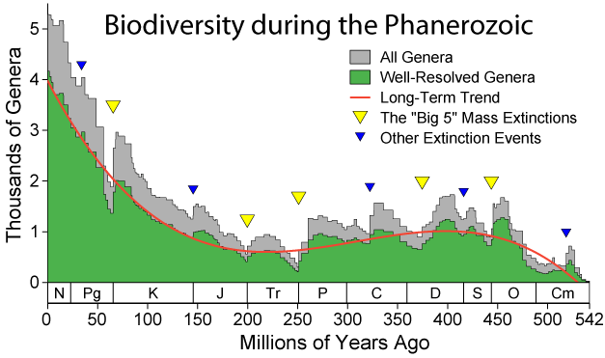

Slide 49
Hox genes – determine placement of arms, legs, wings…
Could have affected evolution through small changes in timing during embryonic development

Slide 50
Test Prep Questions
5 conditions for Genetic Equilibrium:
Random Mating
Large population
No movement into or out of population
No mutations
No natural selection

