Slide 1
H. Genes and Proteins 1. Genes are instructions for assembling proteins. 2. Inherited traits depend on the proteins coded by genes DNA → RNA → Protein
The role of RNA and DNA
DNA = The master Plan (the original)
RNA = Blueprint (copy that is moved around)

Slide 2
Questions
Genes within an individual are fixed, unchanging.
How do gene sequences change over time?
How are genes expressed?
If all the cells in the body have a full set of chromosomes, why do they look and act so differently?
Why do genetically identical individuals have different traits?

Slide 3
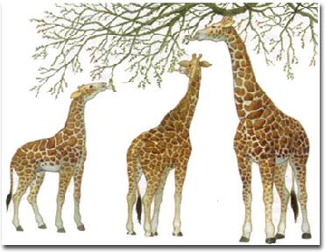

Slide 4
Darwinian Evolution
Notes:
Evolution acts on populations, not on individuals.

Slide 5
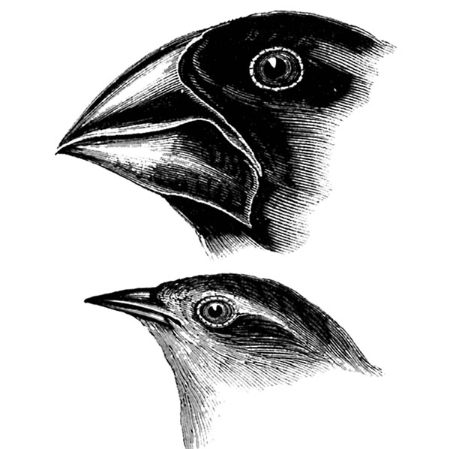
Speciation of Darwin’s Finches
Arrival of the founding population from South America
Separation of populations – island to island
Changes in the Gene Pool – by natural selection

Slide 6
Continued Evolution – 13 species of finches exist today
- Example of: adaptive Radiation, the process by which one species evolves into several different forms that live in different ways.

Slide 7
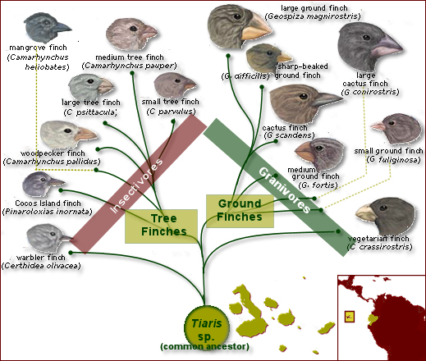

Slide 8
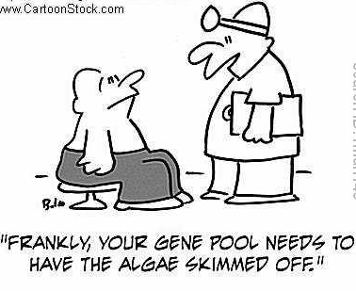
Gene Pools
All of the genes in a population
- Contains 2 or more alleles (forms of a gene) for each trait
2. Relative frequencies - # of times an allele occurs in a gene pool compared to other alleles

Slide 9
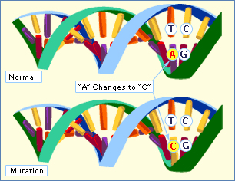
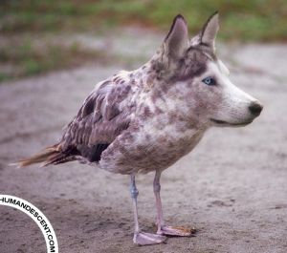
Sources of Genetic Variation
Mutations
- Causes = mistakes in replication, radiation or chemicals
- May or may not effect phenotype

Slide 10
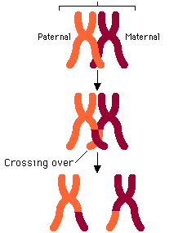
Gene Shuffling – Occurs during production of gametes
- 8.4 million (2^23)different combinations of genes
- Crossing over also increases genotypes

Slide 11
Single Gene and Polygenic Traits
# of phenotypes produced for a given trait depends on the number of genes that control the trait
Single-gene trait – controlled by a single gene that has 2 alleles
Has fewer phenotypes than a polygenic trait
Show’s simple dominant-recessive pattern – Widow’s Peak

Slide 12
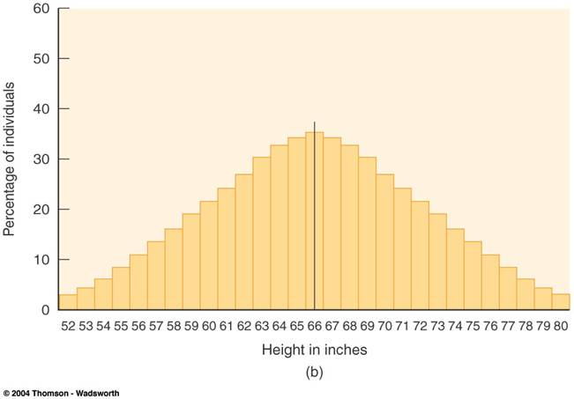
Polygenic Traits – Controlled by 2 or more genes [height]
- Show a wide range of phenotypes

Slide 13
Evolution as Genetic Change
Natural Selection on Single-gene traits
Can lead to changes in allele frequencies & thus to evolution
White moth versus Dark moth example
- Frequency of new allele will increase if this mutation makes some individuals more fit for their environment

Slide 14
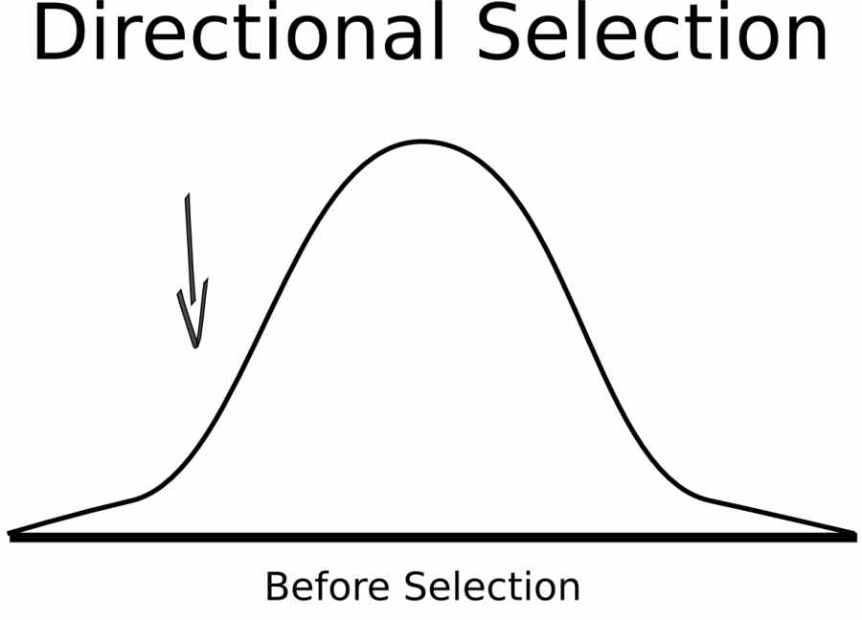
Natural Selection on Polygenic Traits
1. Directional Selection – When individuals at only one end of a bell curve of phenotype frequencies have higher fitness than individuals in the middle or at the other end.

Slide 16
Directional Selection Graphs
Evolution causes an increase in the # of individuals with the trait at one end of the curve
Example: Increase of beak size of finches on the Galapagos

Slide 19
Process of Speciation
Isolating Mechanisms – As new species evolve, populations become reproductively isolated from each other
Reproductive Isolation – Members of two populations cannot interbreed & produce fertile offspring

Slide 20
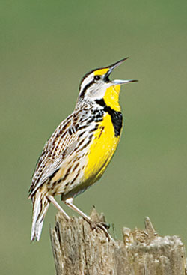
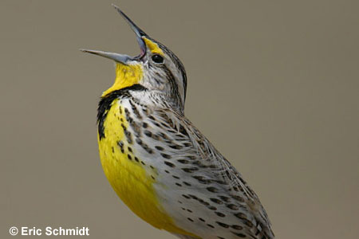
a. Behavioral Isolation: Differences in behavior prevent breeding.
Example: Eastern and western meadowlarks (pg. 404)
Notes:
Wood and leopard frogs exhibit behavioral isolation because the males of each species have vocalizations that only attract females of their species.

Slide 21
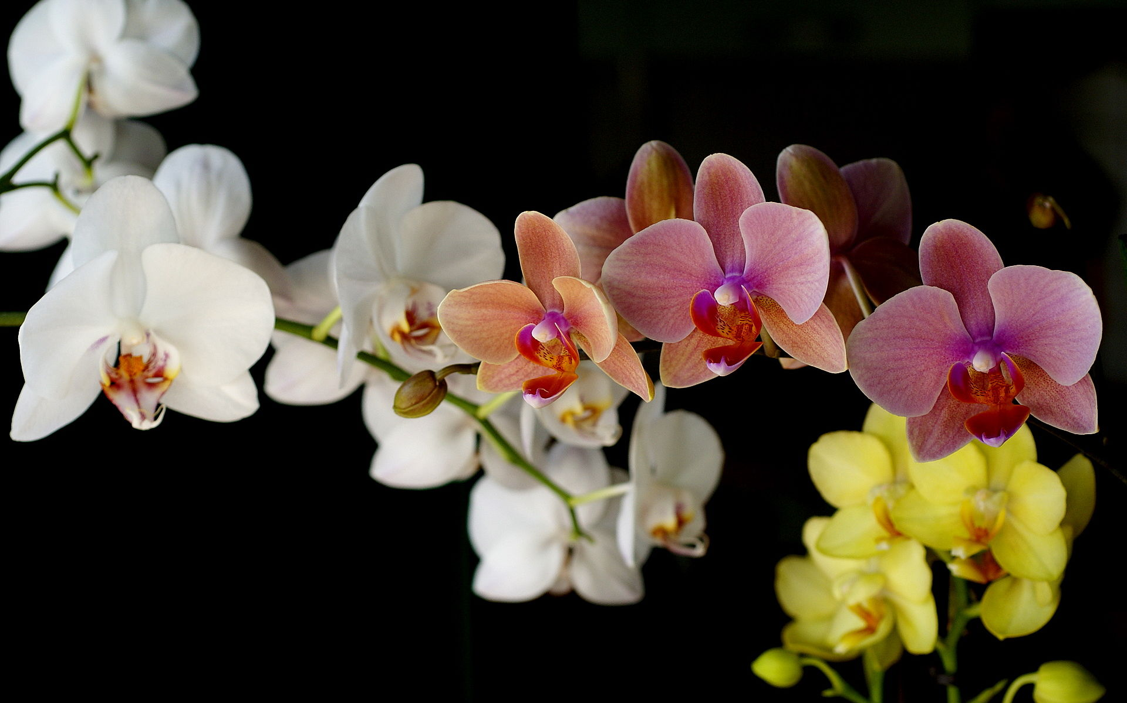
Geographic Isolation: Separation of populations by barriers such as rivers, mountains, canyons, etc.
Temporal Isolation: 2 or more species reproduce at different times.

Slide 22
Testing Natural Selection in Nature (Peter & Rosemary Grant, Darwin’s Finches)
Variation – recorded lots of variation on traits of finches
Natural Selection – big-beaked birds survived during times of food scarcity

Slide 23
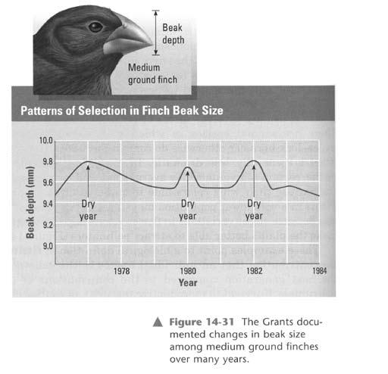

Slide 24
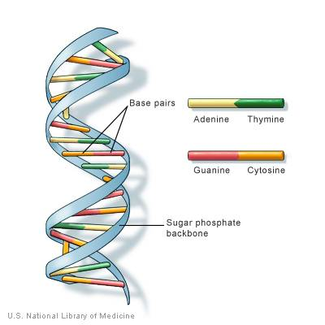
Gene Mutations
Result from changes in a single gene.

Slide 25
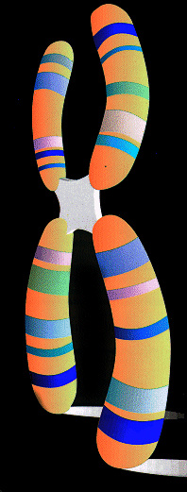
Chromosomal Mutations
Involve changes in whole
chromosomes.

Slide 26
Gene Mutations
Point Mutations
- Occur at a single “point” in DNA
- Affect just one nucleotide
Insertion Deletion Substitution

Slide 27
Deletion
ACT TTC AAA GGC GGA TTT – Original
ACT TTC AAG GCG GAT TT – New

Slide 28
Point Mutations
Substitution

Slide 29
Gene Mutations
Frameshift Mutations
- Insertions and Deletions
- They shift the “reading frame” of Codons

Slide 30
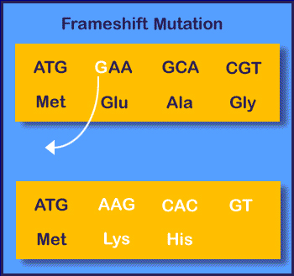

Slide 31
Chromosomal Mutations
- Deletion, Duplication, Inversion, Translocation

Slide 32
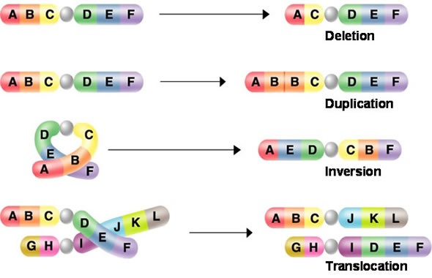
Notes:
A deficiency is the loss of a chromosomal end fragment. Since it occurs normally only in one of two homologous partners, the result is a pairing of a defect and an intact chromosome. Deficiencies can be recognized by this. The intact partner chromosome shows how large the missing fragment of the defect chromosome is. A deletion is the loss of an inner chromosomal fragment. It can be recognized by a loop of the intact partner chromosome at the site where the missing fragment would have been in the defect chromosome. The loop allows conclusions about the size and the site of the deletion. A duplication is the doubling of one or several chromosomal fragments. It shows also as a loop but this time, the loop is in the defect partner chromosome. To find out, whether the loop has been caused by a deletion or a duplication, the band pattern of the chromosome has to be analyzed. The mutation is caused by a duplication, if the band pattern of the loop occurs twice. Usually, the pattern can be found again in a domain neighbouring the loop. The loop is caused by a deletion, if a fragment is missing. An inversion is the change of direction of a chromosomal segment. It results from a segment that has broken out of the chromosome and fused again at the same site but with inverted direction. A pairing of homologous chromosomes is possible, though rather complex loops may be formed. A translocation is the transfer of a chromosomal segment onto a non-homologous chromosome. Translocations were shown in a number of species, like maize Oenothera and others.

Slide 33
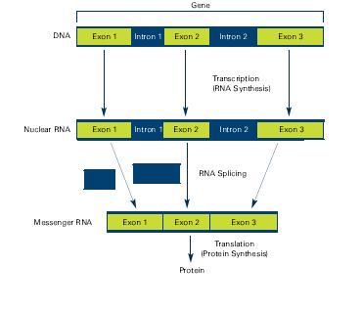

Slide 34
RNA Editing
Many RNA molecules contain more nucleotides than are needed, so they are edited.
Introns – the sequences that are cut out of the RNA.
Exons – The expressed sequences.

Slide 35
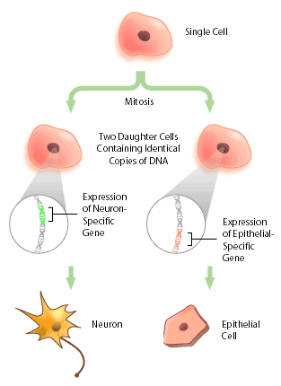

Slide 36
Prokaryotic gene regulation
Cells are able to turn genes “on” and “off.”
Operon – a group of genes that operate together
Notes:
In genetics, an operon is a functioning unit of genomic DNA containing a cluster of genes under the control of a single promoter.[1] The genes are transcribed together into an mRNA strand and either translated together in the cytoplasm, or undergo trans-splicing to create monocistronic mRNAs that are translated separately, i.e. several strands of mRNA that each encode a single gene product.

Slide 37
Gene Regulation
There are regulatory sites on DNA that tell the RNA polymerase where to start transcription.
2. Promoters allow the polymerase to bind to the DNA.

Slide 38
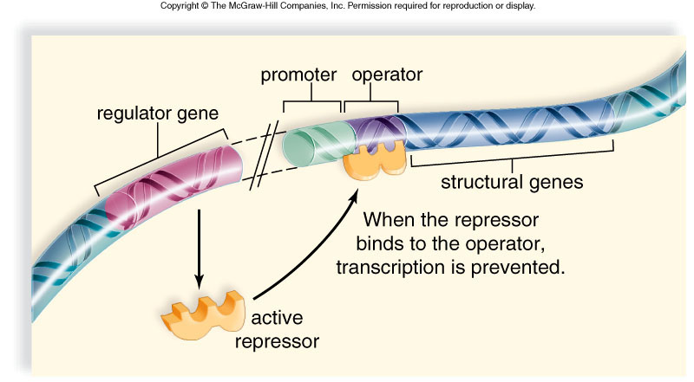
Notes:
Francois Jacob and Jacques Monod (1961) proposed the operon model to explain regulation of gene expression in prokaryotes.In the operon model, several genes code for an enzyme in the same metabolic pathway and are located in a sequence on a chromosome; expression of structural genes is controlled by the same regulatory genes.
Bacteria do not require the same enzymes all the time; they produce just those needed at the moment.Francois Jacob and Jacques Monod (1961) proposed the operon model to explain regulation of gene expression in prokaryotes.In the operon model, several genes code for an enzyme in the same metabolic pathway and are located in a sequence on a chromosome; expression of structural genes is controlled by the same regulatory genes.An operon is a group of structural and regulatory genes that function as a single unit; it includes the following:A regulator gene, located outside the operon, codes for a repressor protein molecule that controls whether the operon is active or not.A promotor is the sequence of DNA where RNA polymerase attaches when a gene is to be transcribed.An operator is a short sequence of DNA where an active repressor binds, preventing RNA polymerase from attaching to the promotor--transcription therefore does not occur.Structural genes are one to several genes coding for enzymes of a metabolic pathway that are transcribed as a unit.

Slide 39
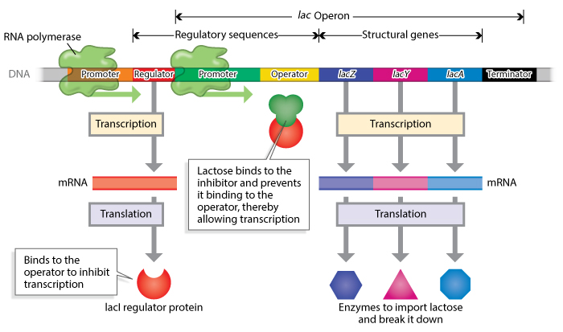
The Lac Operon
Notes:
First, all of the operon's genes are downstream of a single promoter. This promoter serves as a recognition site for the transcriptional machinery of the RNA polymerase complex. Second, all genes in an operon actually become part of a single messenger RNA molecule, which is subsequently translated into individual protein gene products.
In genetics, an operator is a segment of DNA to which a transcription factor binds to regulate gene expression. The transcription factor is typically a repressor, which can bind to the operator to prevent transcription.

Slide 40
So, proteins that bind to regulatory sites on DNA determine whether a gene is expressed.
Eukaryotic Gene Regulation
More complex - promoter sequences
Genes are controlled individually – allows for specialization

Slide 41
What is Epigenetics?
Refers to changes in gene expression caused by mechanisms other than changes in the underlying DNA sequence.
Enables a cell/organism to respond to its dynamic external environment during development and throughout life!
Epigenetic changes to the genome can be inherited if these changes occur in cells giving rise to gametes

Slide 43
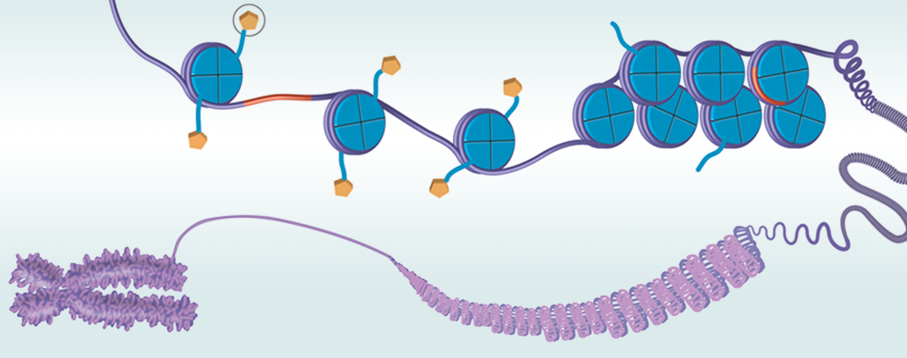
1. Histone modification
If the way that DNA is wrapped around the histones changes, gene expression can change as well.
Histone
Modification
http://ehp.niehs.nih.gov/wp-content/uploads/2012/09/WP_Focus_2_Title_web.png

Slide 44
2. DNA methylation
The addition of methyl groups to DNA, mostly at CpG sites, to convert cytosine to 5-methylcytosine.
5’
3’
SAM
C G T A C A C G A C A C G A T
G C A T G T G C T G T G C T A
3’
5’
Notes:
represent potentially heritable changes to the genome

Slide 45
DNA Methylation leads to gene silencing
Target gene expressed in normal cell
Normal State
RNA pol
TF
Target gene
expressed
Promoter
Target gene inactivated by DNA methylation
Epigenetic Modification
TF
X
Target gene
not expressed
Promoter
Notes:
DNA methylation at promoter regions can impede target gene expression
CpG sites are regions of DNA where a cytosine nucleotide occurs next to a guanine nucleotide in the linear sequence of bases along its length.
*"CpG" stands for cytosine and guanine separated by a phosphate (—C—phosphate—G—), which links the two nucleosides together in DNA.

