Slide 1
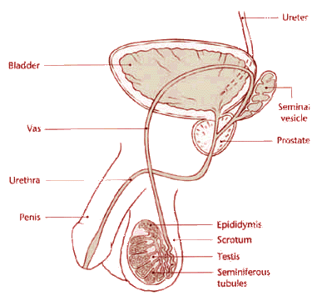

Slide 2
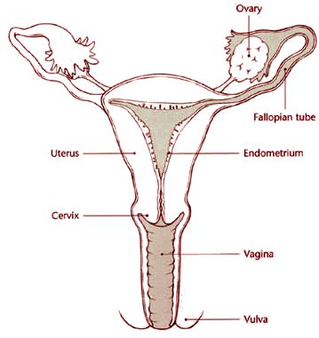

Slide 3
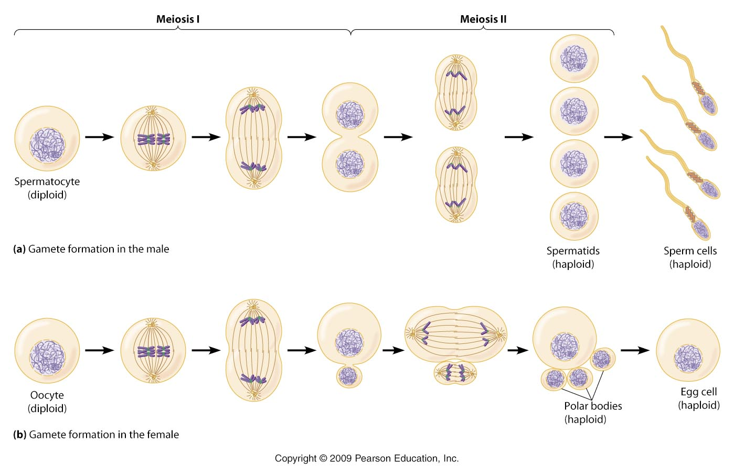

Slide 4
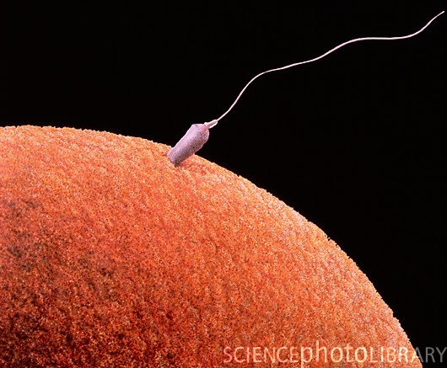

Slide 5
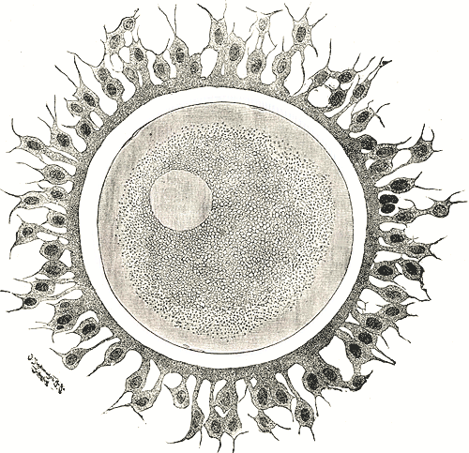

Slide 7
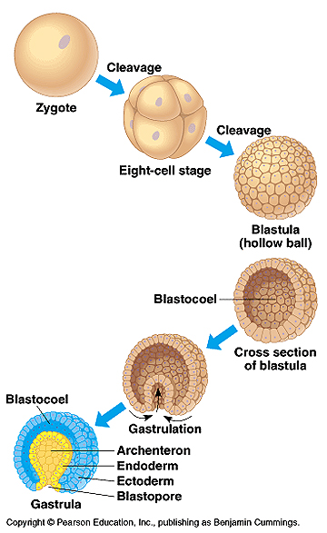

Slide 8
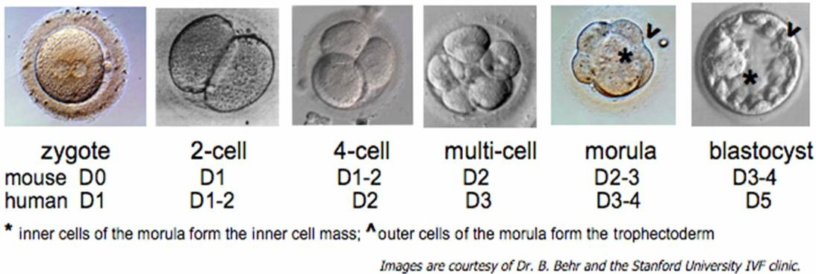

Slide 9
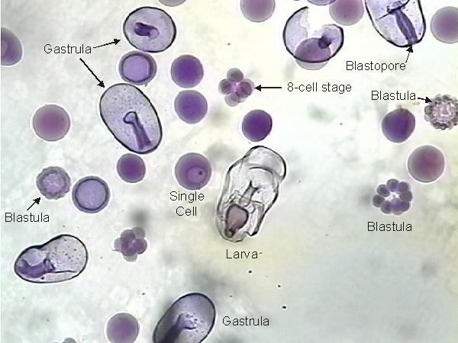

Slide 10
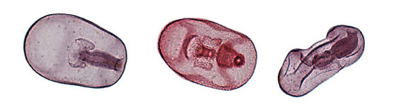

Slide 11
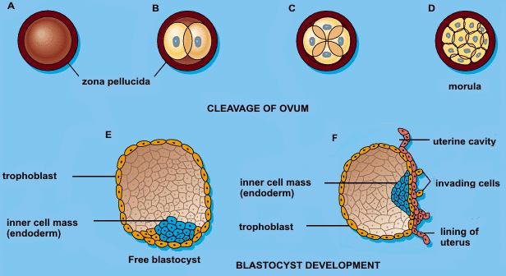

Slide 12
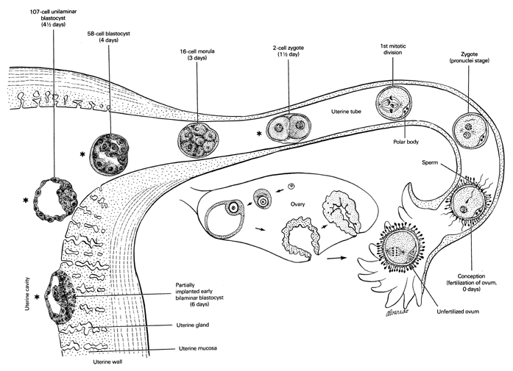

Slide 13
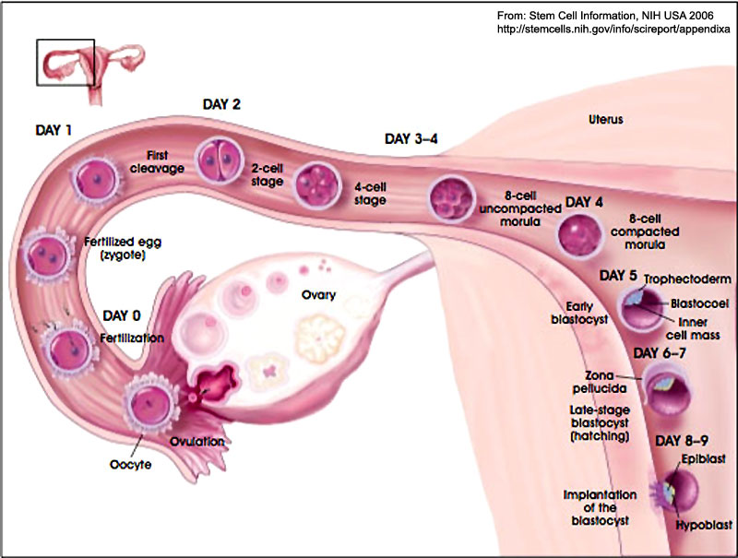

Slide 15
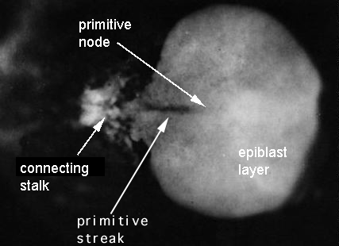

Slide 16
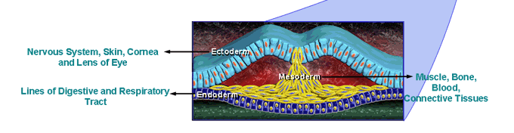

Slide 17
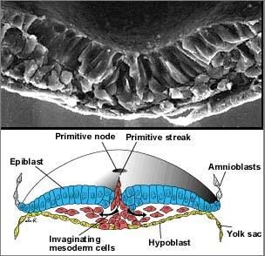

Slide 18
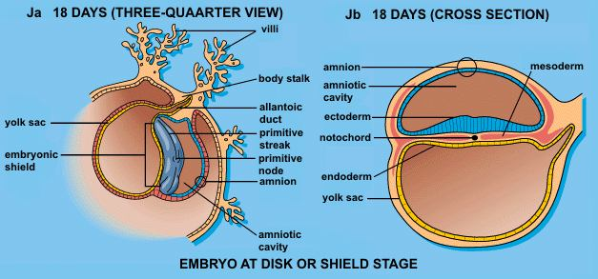

Slide 19
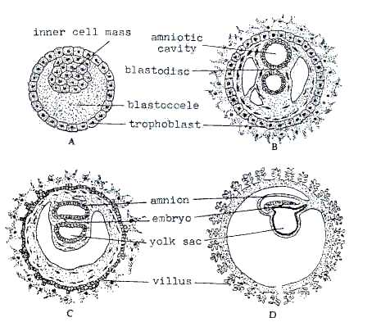

Slide 20
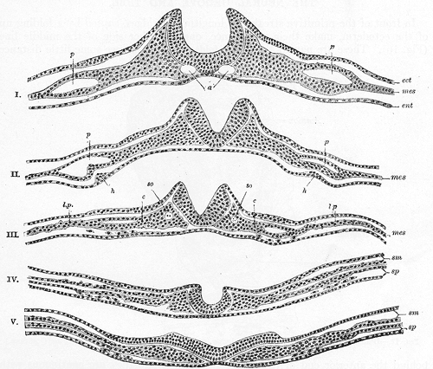

Slide 21
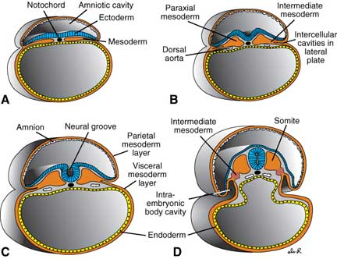

Slide 22
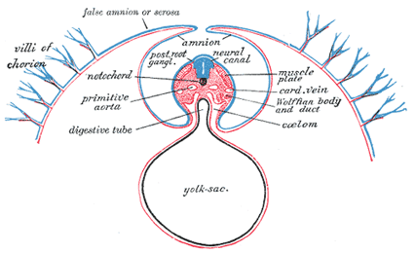
Transverse Folding

Slide 23
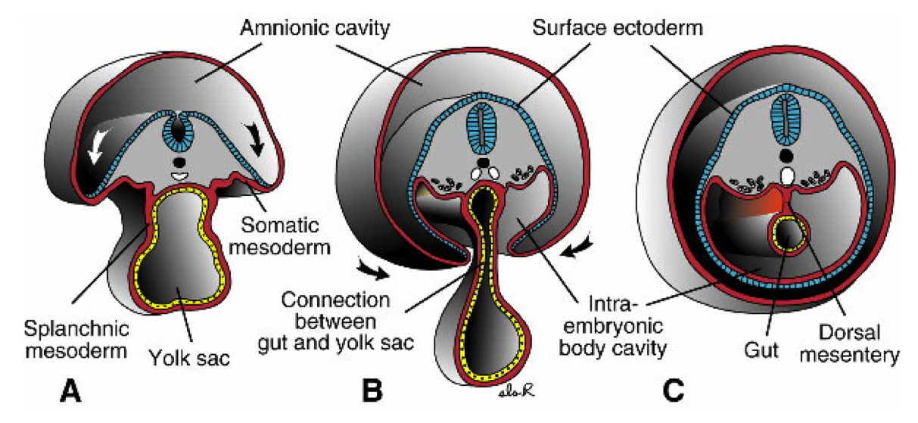
Transverse Folding

Slide 24
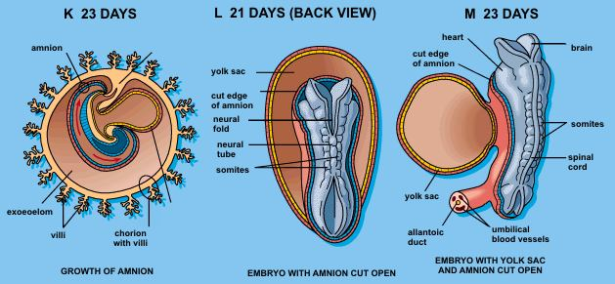
Cehpalocaudal Folding

Slide 25
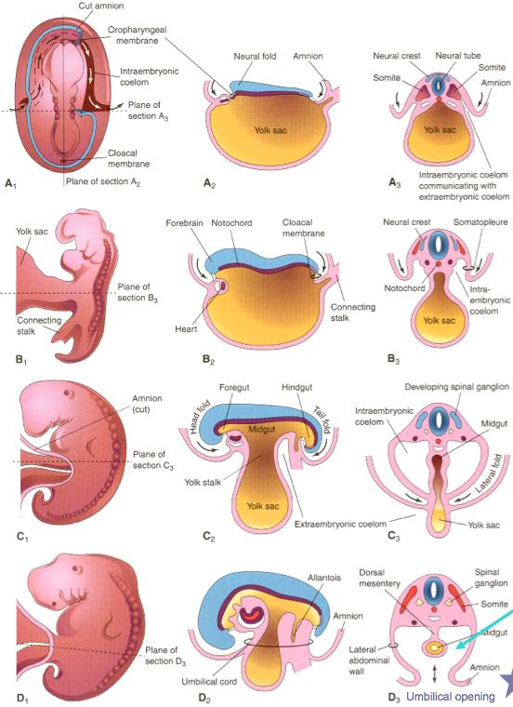

Slide 26
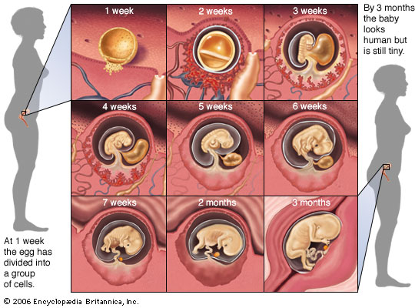

Slide 27
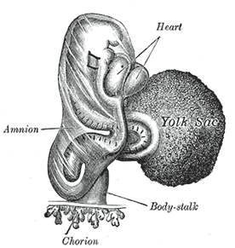
Week 3
Notes:
Second Week.—By the end of this week the ovum has increased considerably in size, and the majority of its villi are vascularized. The embryo has assumed a definite form, and its cephalic and caudal extremities are easily distinguished. The neural folds are partly united. The embryo is more completely separated from the yolk-sac, and the paraxial mesoderm is being divided into the primitive segments (Fig. 58).

Slide 28
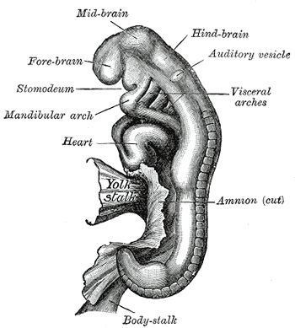
Week 4
Notes:
Third Week.—By the end of the third week the embryo is strongly curved, and the primitive segments number about thirty. The primary divisions of the brain are visible, and the optic and auditory vesicles are formed. Four branchial grooves are present: the stomodeum is well-marked, and the bucco-pharyngeal membrane has disappeared. The rudiments of the limbs are seen as short buds, and the Wolffian bodies are visible (Fig. 59).
The stomodeum, also called stomatodeum or stomatodaeum, is a depression between the brain and the pericardium in an embryo, and is the precursor of the mouth and the anterior lobe of the pituitary gland.
visceral arch mesenchymal structures in the region of the embryonic pharynx and visible on the ventrolateral aspect of the head; give rise to skeletal elements, larynx and other structures of the head.
mandibular arch, is the first of six pharyngeal arches that develops in fetal life during the fourth week of development.[1] It is located between the stomodeum and the first pharyngeal groove.
The larynx (/ˈlærɪŋks/) (plural larynges), commonly called the voice box, is an organ in the neck of amphibians, reptiles, and mammals (including humans) involved in breathing, sound production, and protecting the trachea against food aspiration.

Slide 29
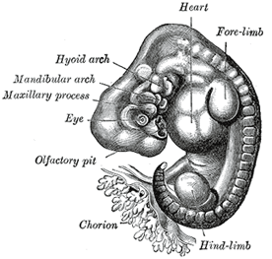
27 – 30 Days
Notes:
Fourth Week.—The embryo is markedly curved on itself, and when viewed in profile is almost circular in outline. The cerebral hemispheres appear as hollow buds, and the elevations which form the rudiments of the auricula are visible. The limbs now appear as oval flattened projections (Fig. 60).
The second pharyngeal arch or hyoid arch (or second branchial arch) assists in forming the side and front of the neck.
The maxillary process forms the lateral wall and floor of the orbit, and in it are ossified the zygomatic bone and the greater part of the maxilla; it meets with the lateral nasal process, from which, however, it is separated for a time by a groove, the naso-optic furrow, that extends from the furrow encircling the eyeball to the olfactory pit.

Slide 30
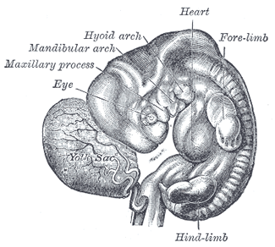
31 – 34 Days
Notes:
Fifth Week.—The embryo is less curved and the head is relatively of large size. Differentiation of the limbs into their segments occurs. The nose forms a short, flattened projection. The cloacal tubercle is evident (Fig. 61).

Slide 31
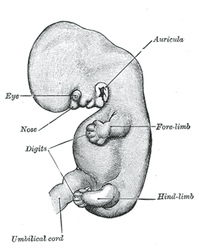
6 Weeks
Notes:
Sixth Week.—The curvature of the embryo is further diminished. The branchial grooves—except the first—have disappeared, and the rudiments of the fingers and toes can be recognized (Fig. 62).
auricle [aw´rĭ-k'l]1. the projecting part of the ear lying outside the head; called also pinna.

Slide 32
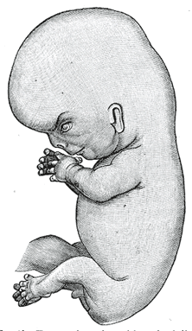
8 Weeks
Notes:
Seventh and Eighth Weeks.—The flexure of the head is gradually reduced and the neck is somewhat lengthened. The upper lip is completed and the nose is more prominent. The nostrils are directed forward and the palate is not completely developed. The eyelids are present in the shape of folds above and below the eye, and the different parts of the auricula are distinguishable. By the end of the second month the fetus measures from 28 to 30 mm. in length (Fig. 63).

Slide 33
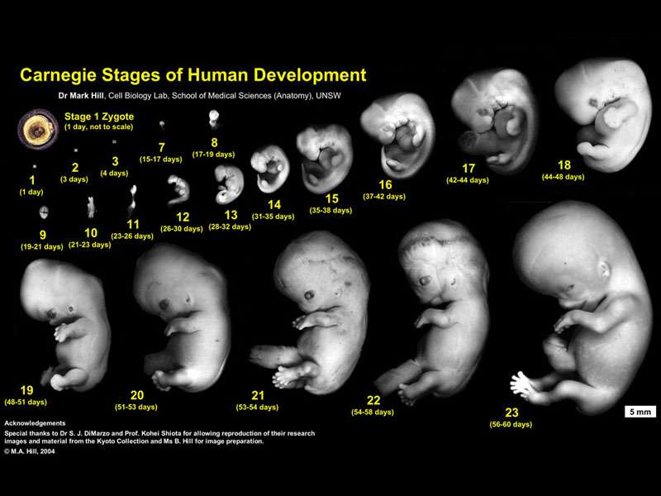

Slide 34
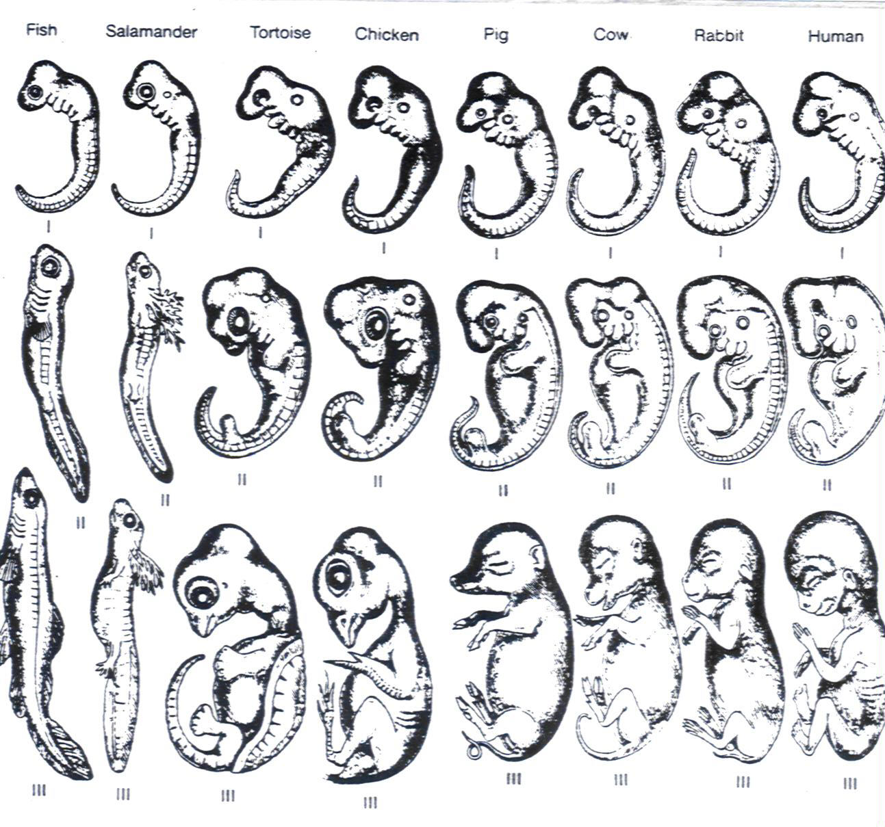

Slide 35
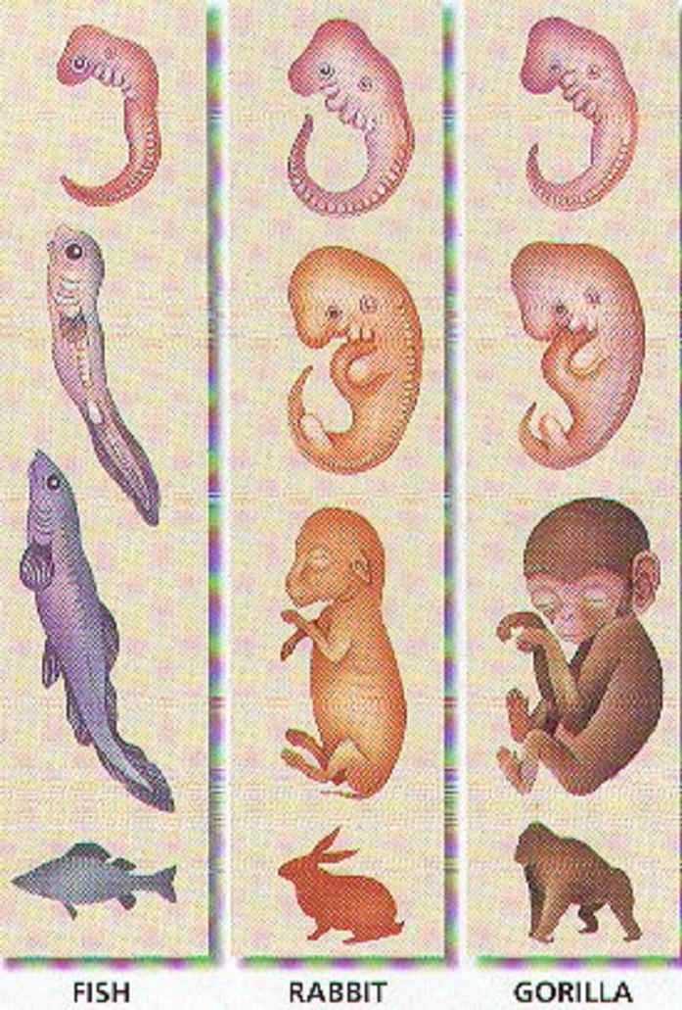

Slide 36
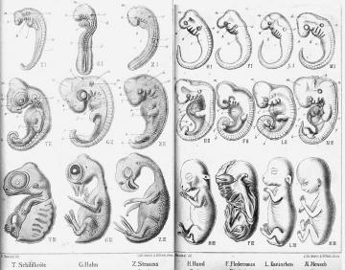

Slide 37
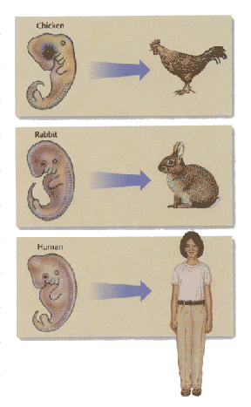

Slide 38
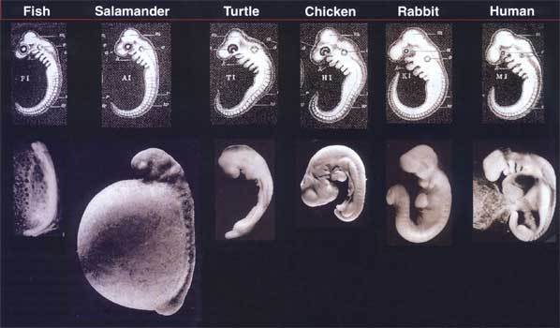

Slide 39
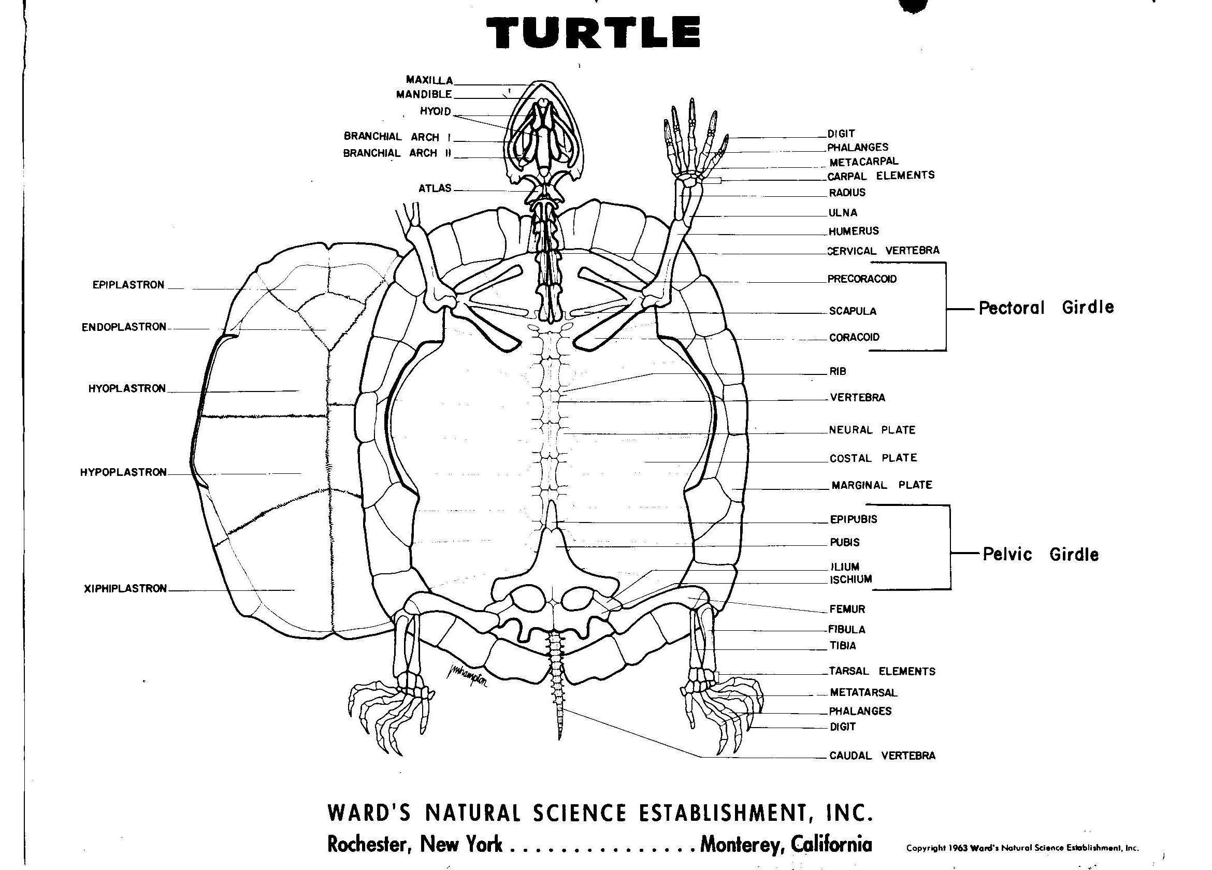

Slide 40
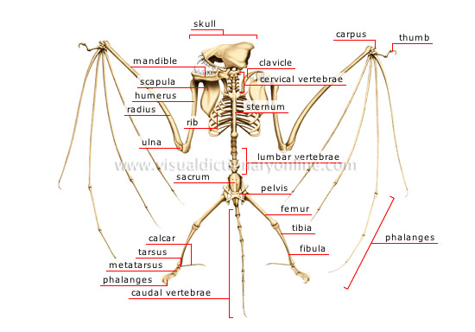

Slide 41
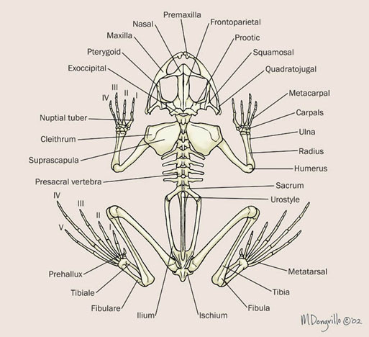

Slide 42
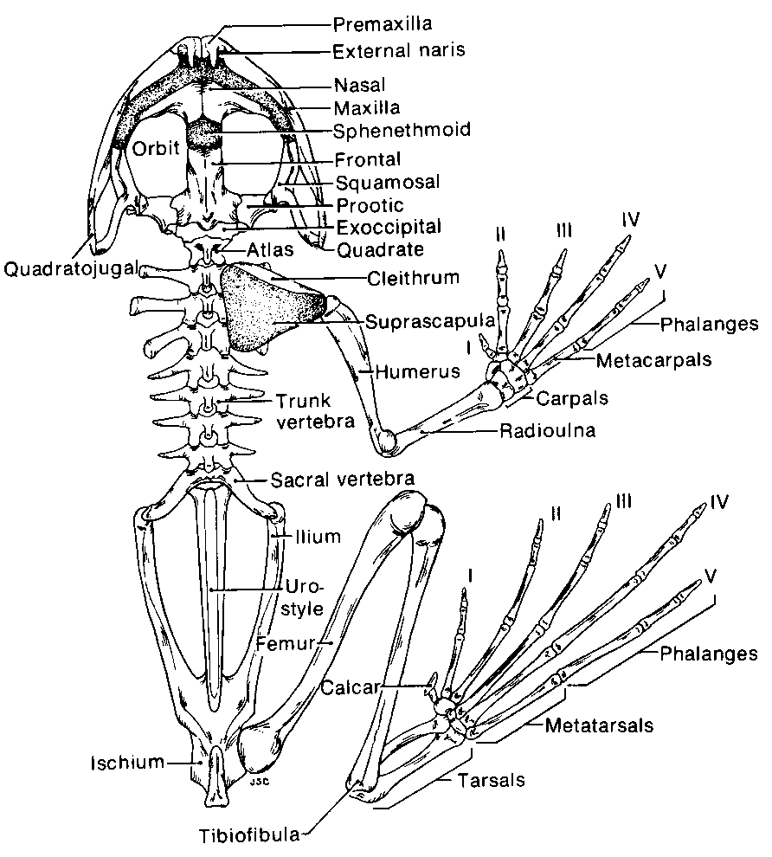

Slide 43
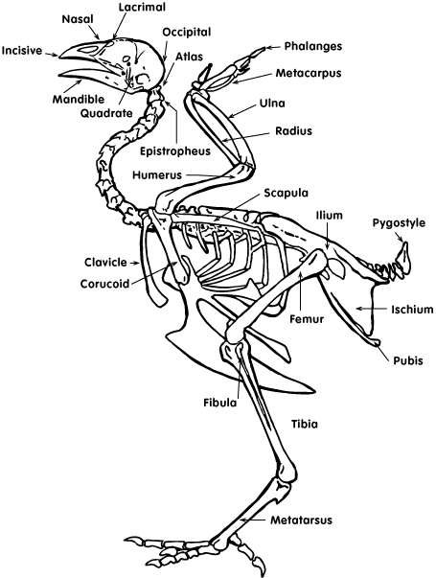

Slide 44
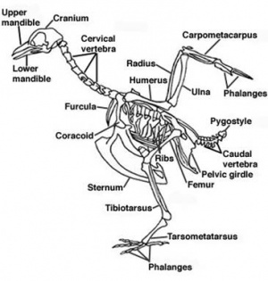
Sparrow

Slide 45
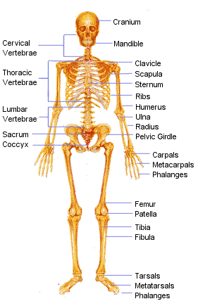

Slide 46
