Slide 1
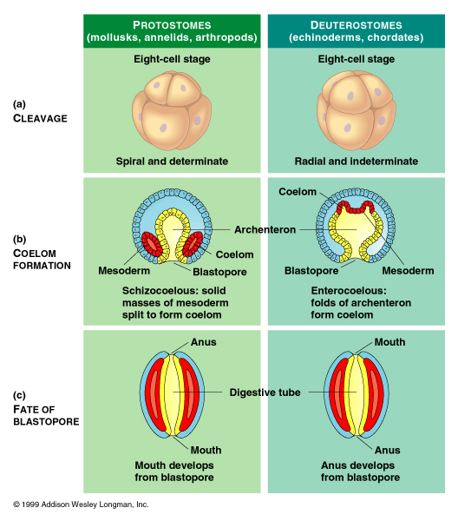

Slide 2
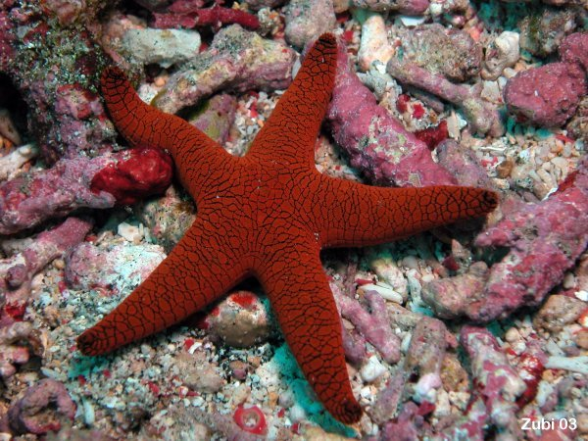
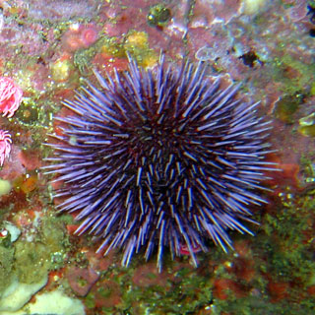

Slide 3
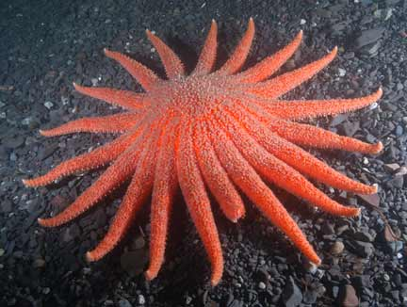

Slide 4
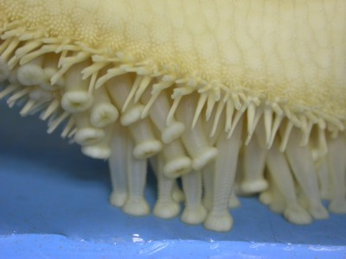

Slide 5
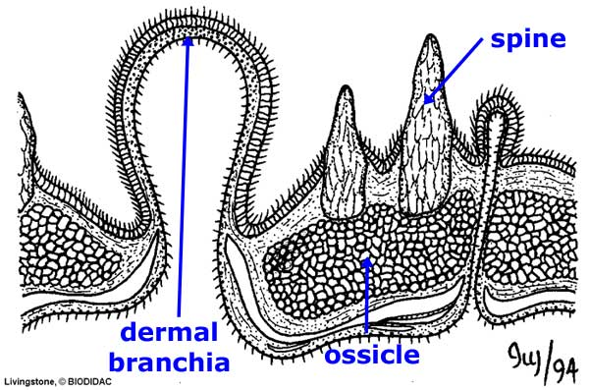

Slide 6
Notes:
An endoskeleton composed of calcium carbonate plates called ossicles. Although it may appear otherwise, the fact that the ossicles are covered by a layer of epidermis defines the skeleton as an endoskeleton. Also note that the skeletal material of echinoderms, calcium carbonate (CaCO₃, is distinct from that found in the endoskeletons of vertebrates. Vertebrate endoskeletons are made of calcium phosphate. The water vascular system, which is a system of hydrostatic organs involved in locomotion, respiration, and feeding. This system is blind ended, with the madreporite being the valve controlling the movement of sea water into and out of the system. The madreporite communicates with a centrally located ring canal via a single stone canal, named for the calcification of its walls. The ring canal, as the name suggests, encircles the central disc and gives off radial canals into each of the animal's arms. These radial canals give rise to many short, valved lateral canals that end in tube feet. Tube feet are muscular and consist of an ampulla (which acts as a pump, pressurizing the tube foot when the lateral canal valve is closed) and a podium (which acts as a foot, contacting surfaces in the environment). The various canals of the water vascular system are ciliated and always fluid-filled. Note that adhesion by the tube feet is primarily chemical - the tube foot secretes a substance that bonds with the surface and another chemical that breaks those bonds and releases the tube foot. This type of adhesion makes sense considering that echinoderms may need to grip very tightly to surfaces for long periods of time to resist wave action. If it depended on muscular contraction long-term, strong adhesion that would require a great deal of energy. Because the tube feet are very thin-walled, their surface is suitable for the diffusion of oxygen into the body cavity and the diffusion outward of carbon dioxide and wastes. Many groups have developed auxiliary respiratory structures, for example, sea stars typically have short gills extending up between the ossicles of their aboral surfaces. Special collagenous tissues which are normally rigid, but can be temporarily unlocked, allowing echinoderms to maintain postures without muscular effort - again, an efficient solution to the problem of holding on for long periods of time in a high energy environment. For more information on these "mutable connective tissues" - Natural Histroy Magazine: Catch and release - sea cucumbers might put a torn Achilles tendon back together again.

Slide 7
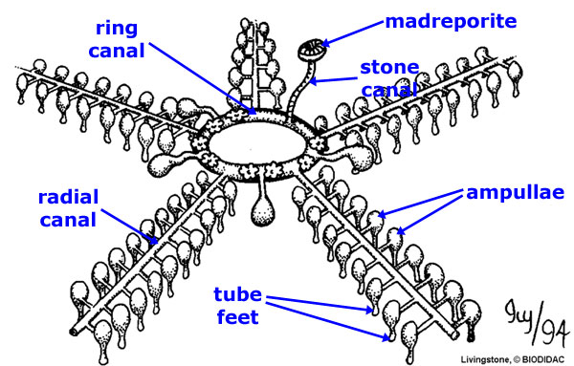

Slide 8
