Slide 1
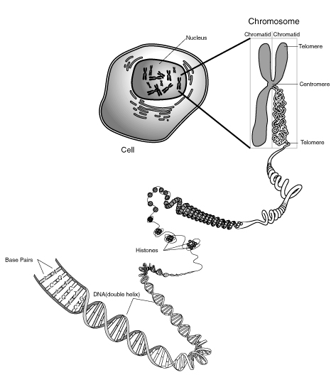

Slide 2
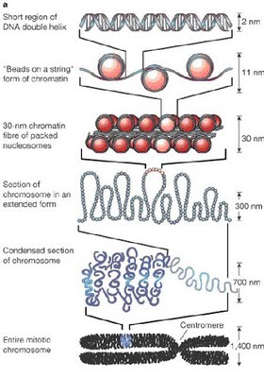

Slide 3
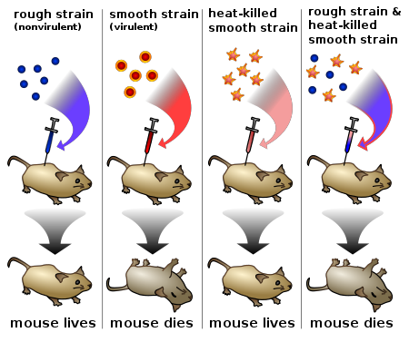

Slide 4
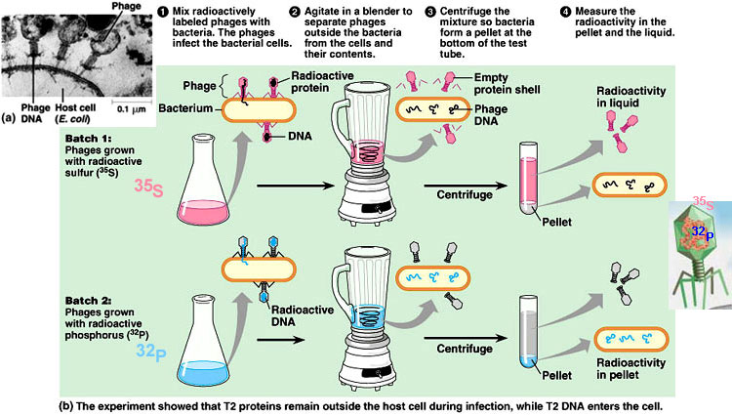

Slide 5
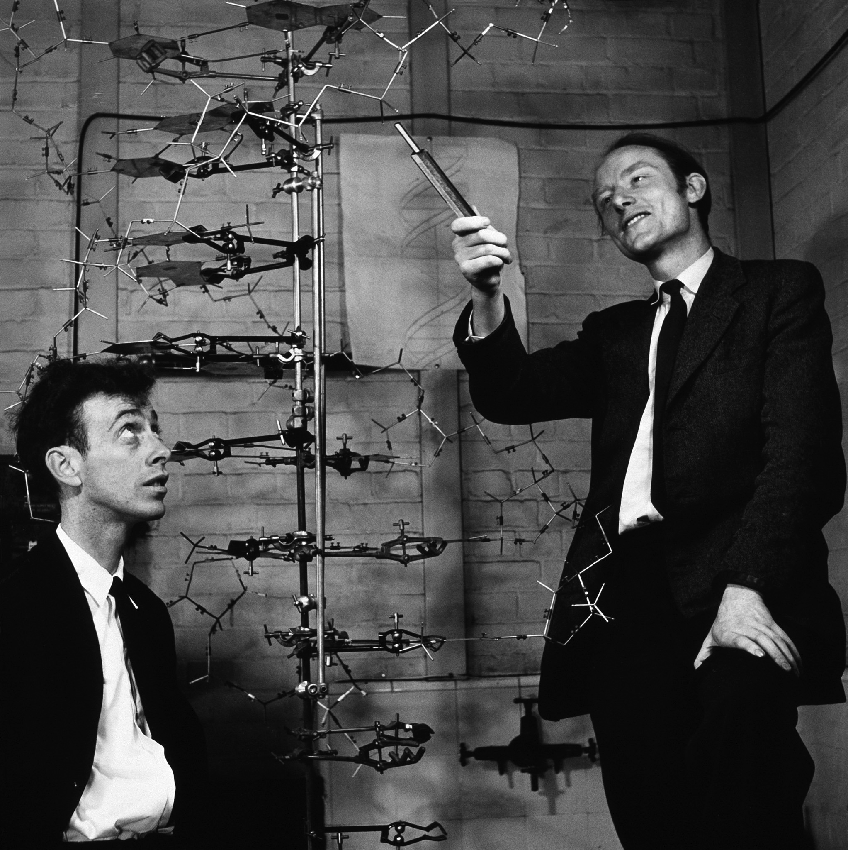
Notes:
On February 28th, 1953, Francis Crick and James Watson figured out that DNA had a double-helix structure by creating a model out of bits of stuff in the lab and comparing it to X-ray diffraction data collected by X-ray crystallographer Rosalind Franklin and molecular biologist Maurice Wilkins.

Slide 6
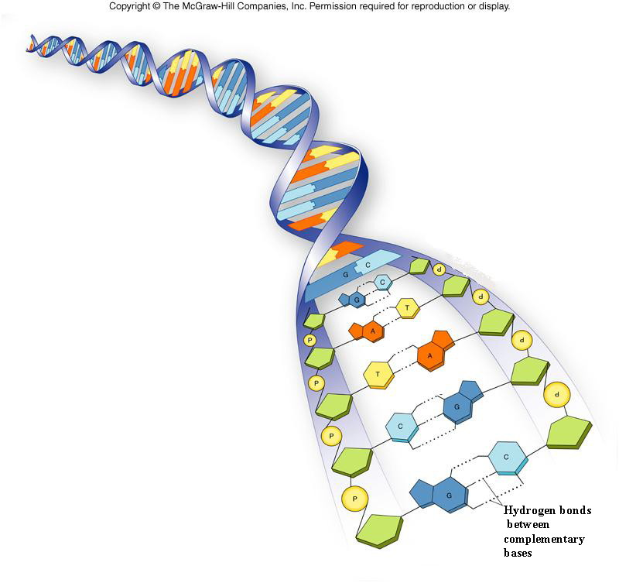

Slide 7
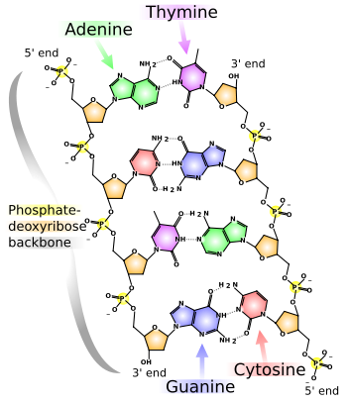

Slide 8
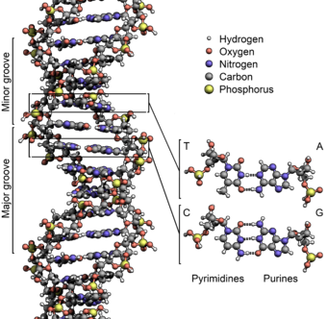

Slide 9
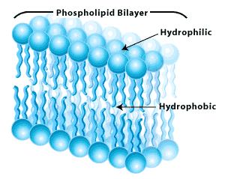

Slide 10
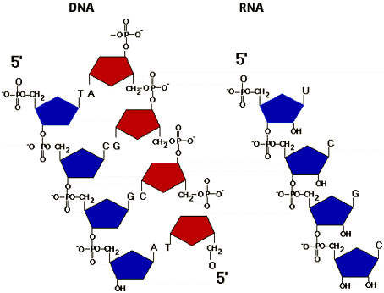

Slide 11
